Slide 1
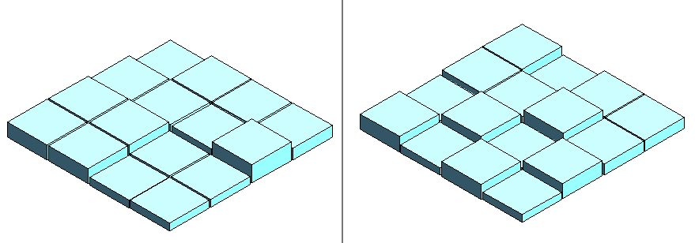
Diophantine optics in interferometry:
Laboratory performances of the
chessboard phase shifter
Daniel Rouan, Damien Pickel, Jean-Michel Reess, Olivier Dupuis – LESIA
Didier Pelat – LUTH
Fanny Chemla, Mathieu Cohen – GEPI
Observatoire de Paris

Slide 2
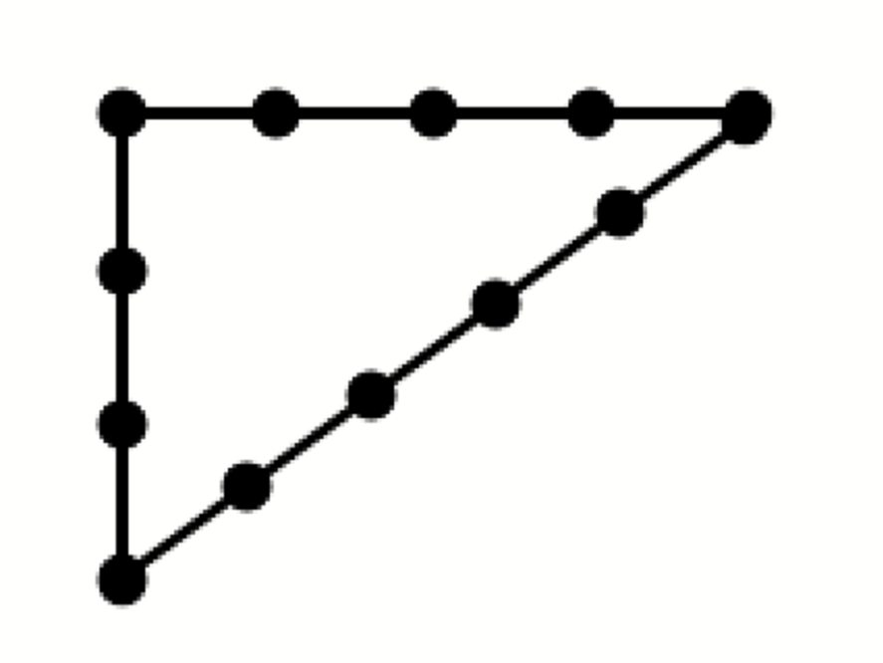
Diophantine optics
Diophantus of Alexandria: greek mathematician, known as the « father of algebra »
He studied polynomial equations with integer coefficients and integer solutions such as (x-1)(x-2) = x² -3x +2 = 0 called diophantine equation The most famous one : the egyptian triangle 5² = 4² + 3²
Optics and power of integers ?
constructive or destructive interferences ➜ optical path differences = multiple integer (odd or even) of /2
complex amplitude = highly non-linear function of the opd ➜ Taylor development implies powers of integers
Diophantine optics = exploitation in optics of some remarkable algebraic relations between powers of integers
Application in direct detection of exoplanets

Slide 3
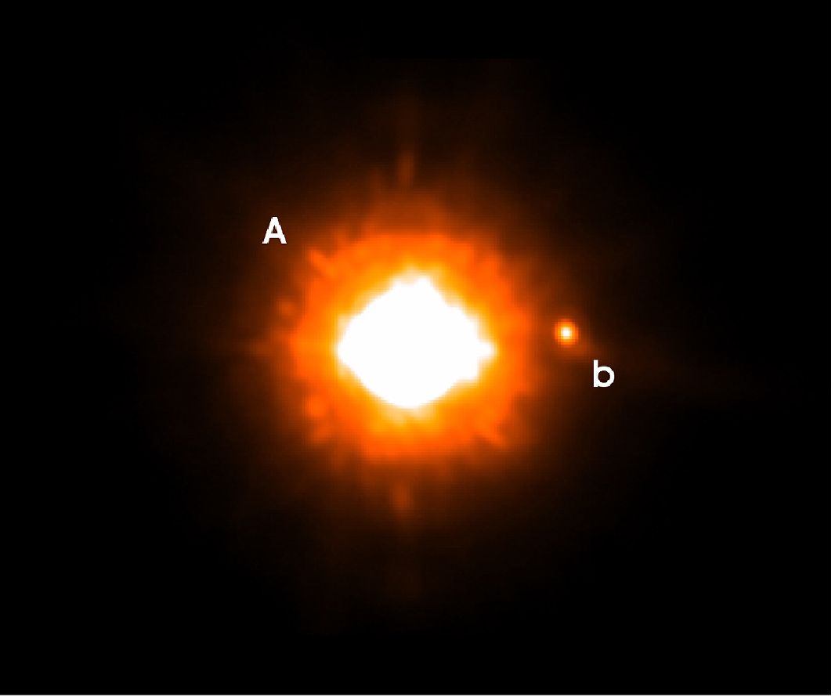
Directly detecting an Exoplanet is a hard task
Angular separation
10¹⁰
10⁷
Contrast

Slide 4
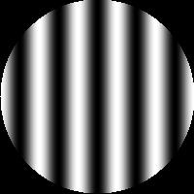
Exoplanet direct detection
Two avenues :
In visible/near-IR : single telescope + adaptive optics + coronagraphy
In infrared : multi-telescopes + space + nulling interferometry
Image plane
Pupil plane

Slide 5
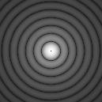
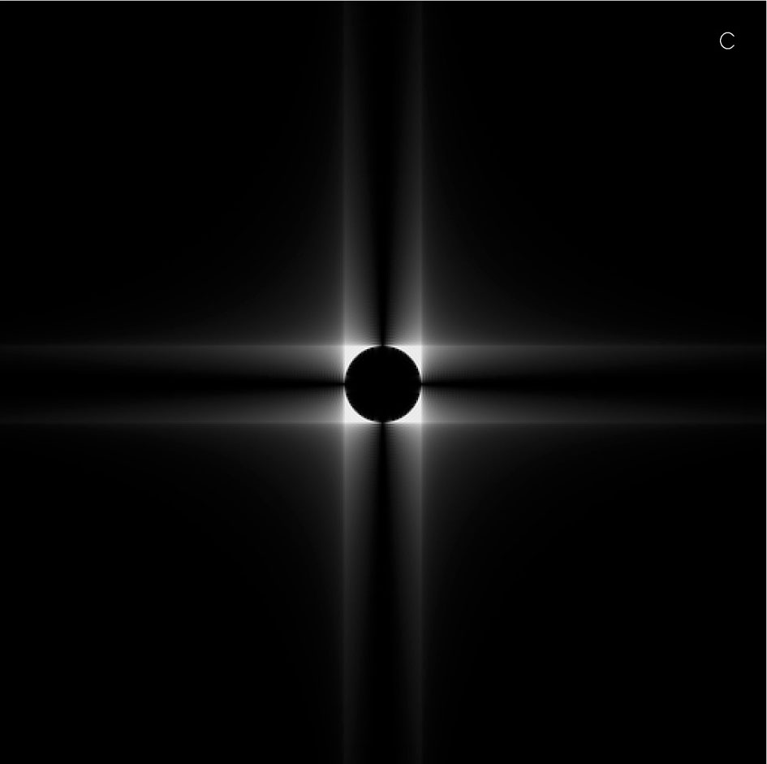
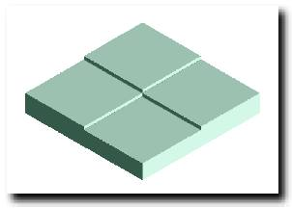
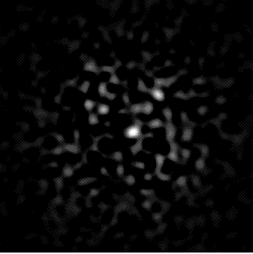
4 quadrants phase mask coronagraph
A transparent mask
mask
stop

Slide 6
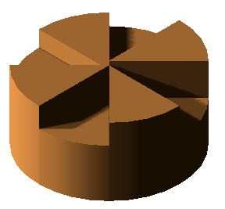
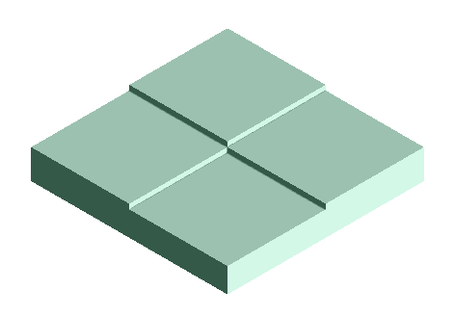
Achromatism of phase mask coronagraph
Improving achromatism in phase mask coronagraph
Play with combinations of quadrant thickness to cancel the first terms of the Taylor development of the complex amplitude a =  ± exp(j k ) where  =   
Classical 4QPM : steps = [0, 1, 0, 1] -> a ≈ 
4QPMC : 2nd order with steps = [0, 1, 2, 1] a ≈ ()²
8QPMC : 3rd order with steps = [1, 8, 3, 6, 2, 7, 2, 7] a ≈ ()³
A 4QPMC component just manufactured : to be tested soon

Slide 7
Nulling interferometry
Bracewell-type nulling interferometer
Success depends on several challenges, one being the achromatic  phase shift within the bandpass (typically one to two octave)
Star
θ
Planet
D.sinθ
D
T1
π
T2
Recombination

Slide 8
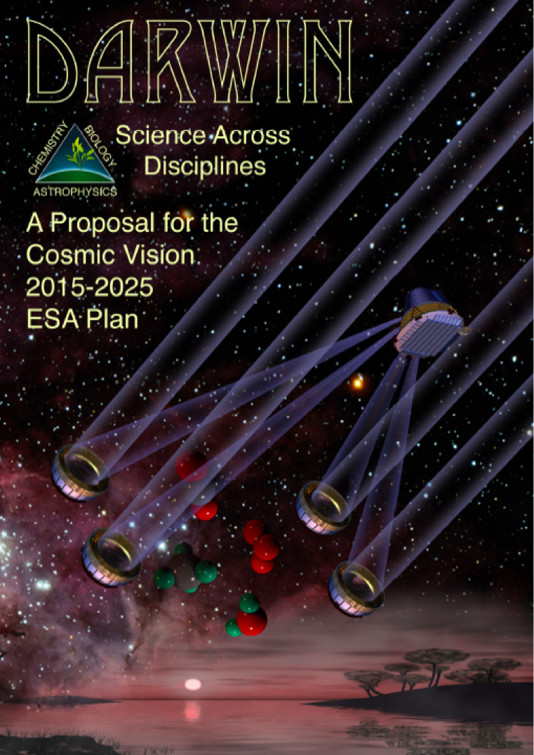
Life on exoplanet: tracers in the mid-IR
Observed spectra
Signatures of three key components: H₂O, O₃, CO₂
Broad range of  : from 6 to 18 µm
Detecting those bands : goal of a future Darwin-type space project
H2O O3 CO2
6 8 10 15 20 μm

Slide 9
Avoiding long delay lines
3-telescopes nulling interferometer in space
How recombining the beams on one of the spacecraft, without prohibitive long delay lines ?
Use relay mirrors and diophantine relations between spacecraft distances
4
4
Optical path = 13
3
5
Optical path = 4+4+5 = 3+5+5 = 13
Optical path = 18

Slide 10
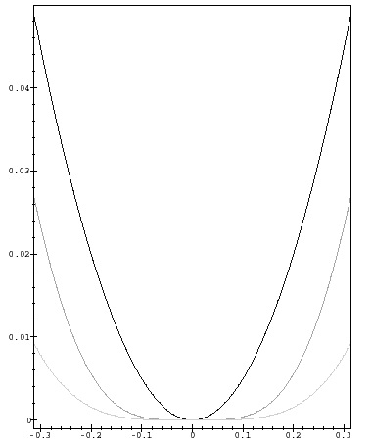
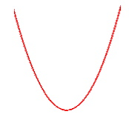
Deep nulling
In a Bracewell nulling interferometer, the stellar disk is resolved ➜ leaks of light
To obtain a deep and flat nulling function in a multi-telescopes interferometer
distribute the telescopes with a p phase shift according to the Prouhet-Thué-Morse series 0110100110010110…
nulling varies then as q^{n} with n as high as wished
The coefficients of the Taylor development of the complex amplitude vanish thanks to diophantine relations between sums of powers of 2^{L} first integers 0 1 1 0 1 0 0 1 … 1 2 3 4 5 6 7 8 … 2^{L} ∑n_{k}^{p} = ∑m_{k}^{p} for all p < L-1
p 0 0 p 0 p p 0

Slide 11
Quasi-achromatic phase shift in a nulling interferometer
The (diophantine) chessboard phase shifter

Slide 12
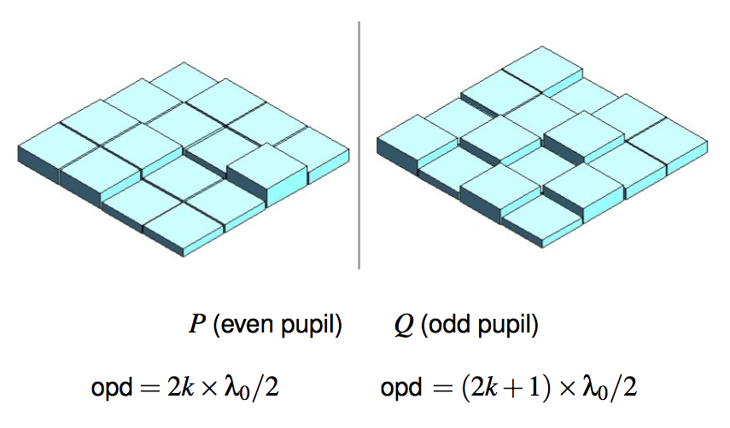
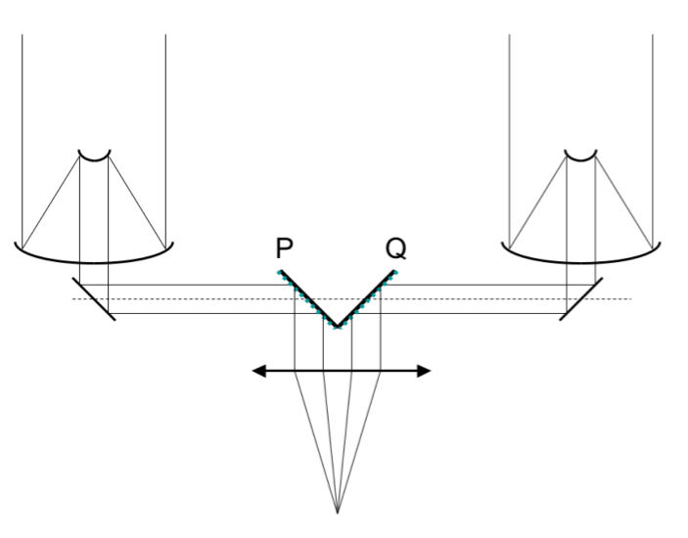
The chessboard phase shifter
A new concept of achromatic phase shifter : the achromatic chessboard (Rouan & Pelat, A&A 2008 ; Pelat, Rouan, Pickel, A&A 2010 ; Pickel, Pelat, Rouan et al. , A&A 2013)
Based on a single optical device and some unforeseen application of diophantine equations
The wavefront is divided into many sub-pupils with two “chessboards” of phase-shifting cells, each producing an opd : an even or odd multiple of o/2
The proper distribution of opd produces the quasi-achromatization
Main assets : makes the arms of the interferometer fully symmetric; uses a unique simple component that can be in bulk optics

Slide 13
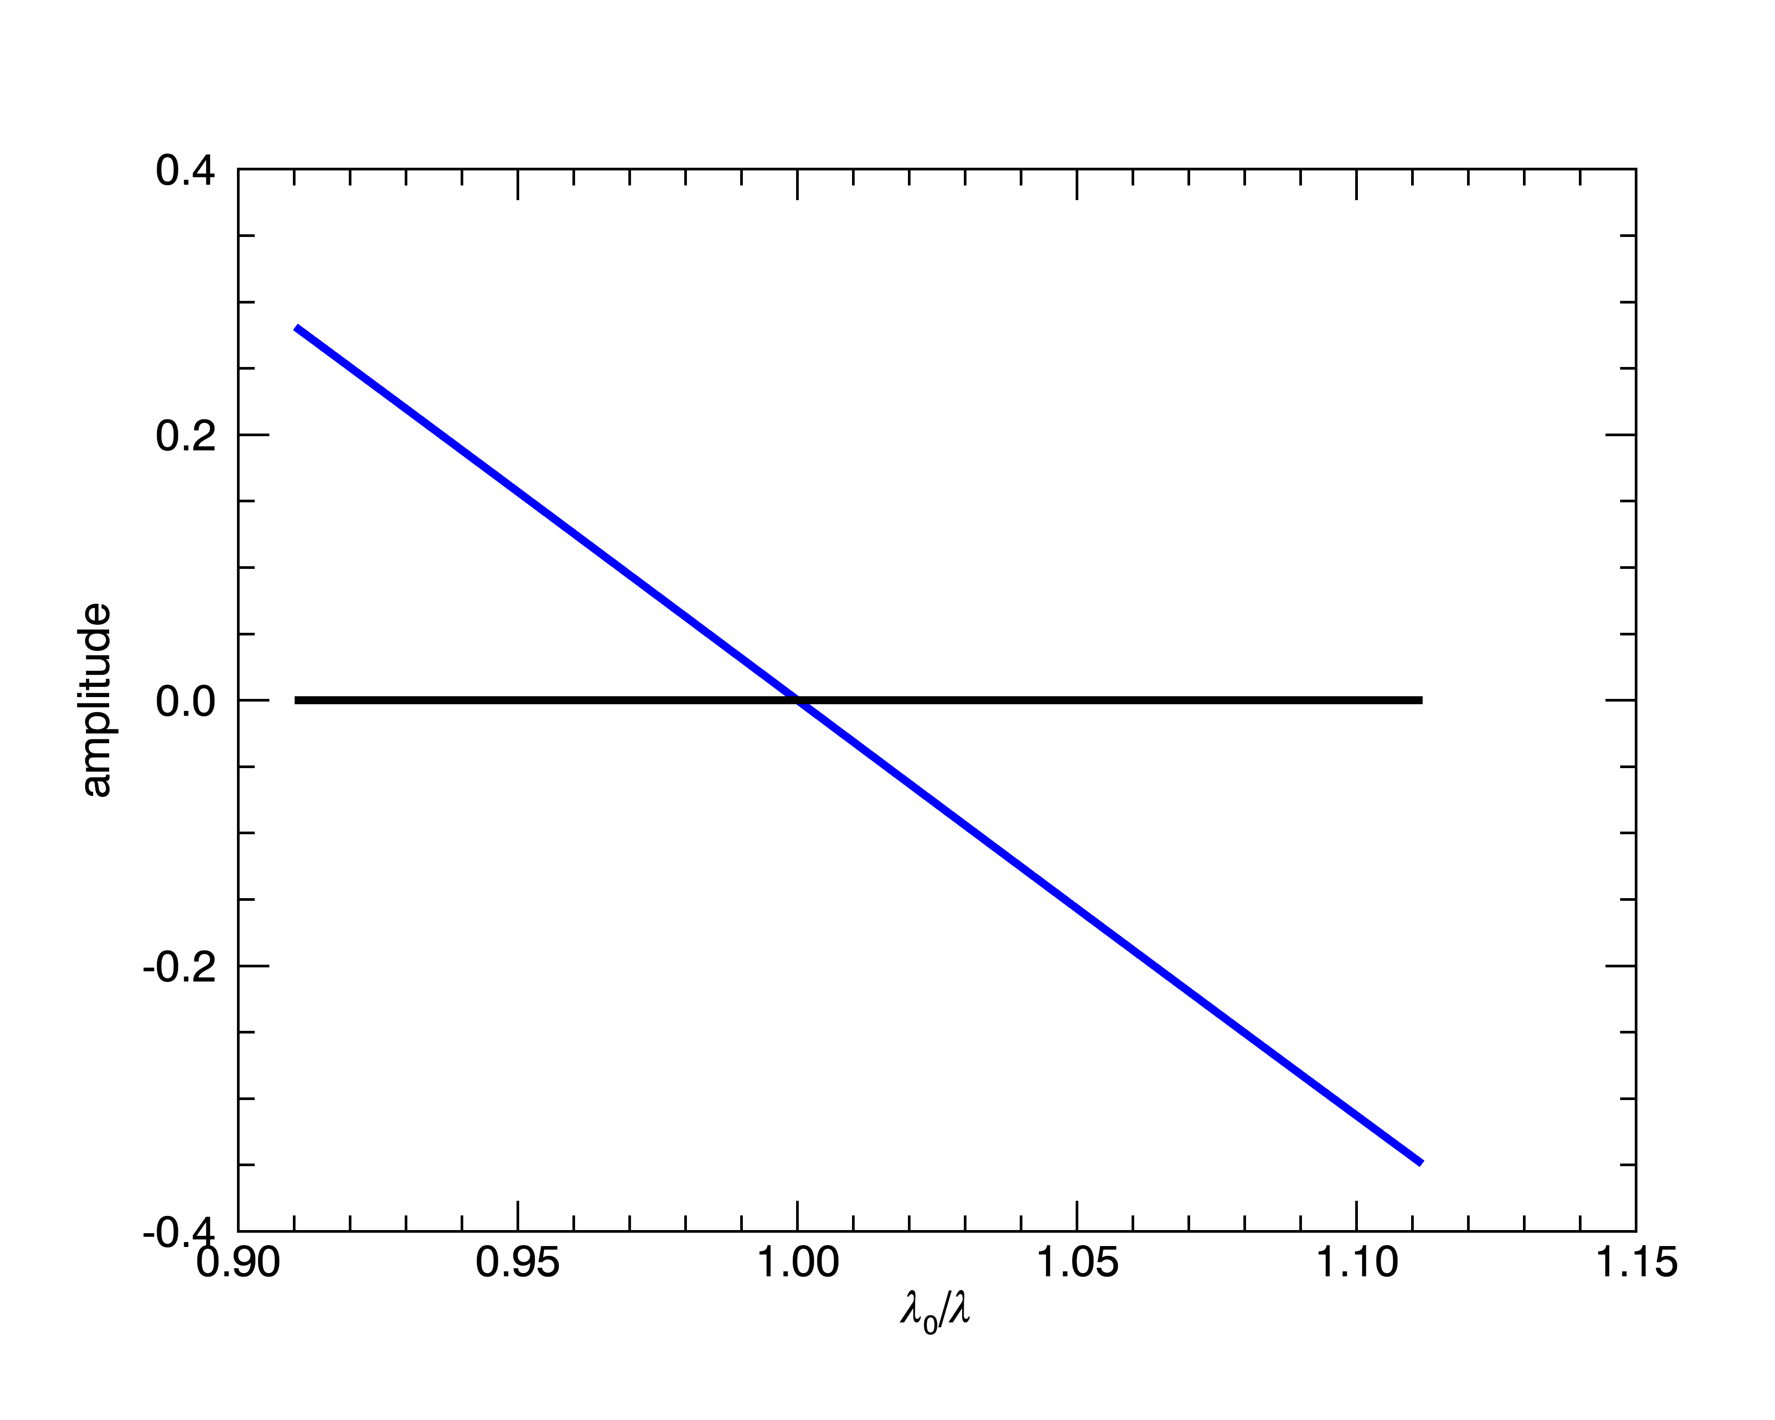
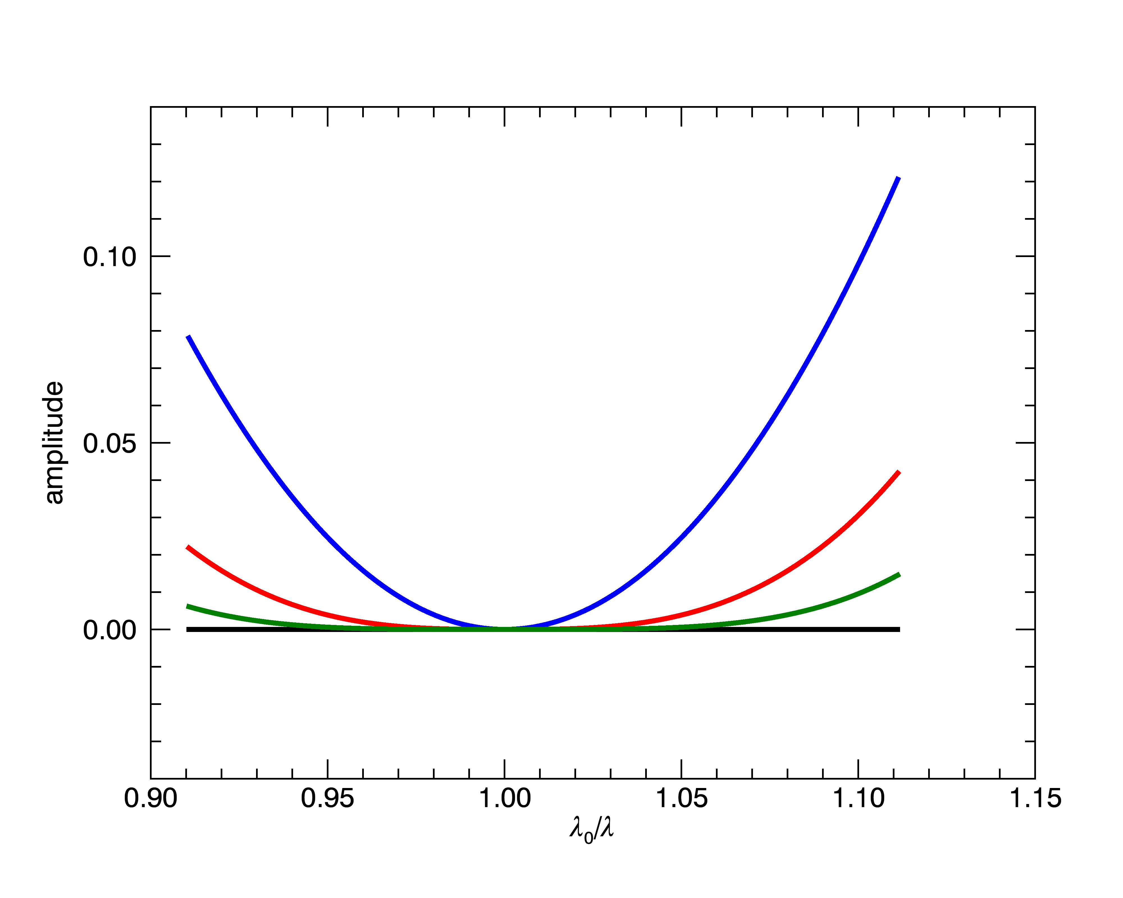
opd distribution : some mathematics…
If z = ( −1) ^{λo /λ} ≡ e ^{iπλo /λ}
the cell with opd = k λ₀/2 has a complex amplitude z^{k}
For a basic Bracewell (one cell per chessboard) the amplitude is Λ = 1 + z That is λ = λ₀ induces a root of order one on Λ.
To obtain a flat Λ around λ₀ let’s produce a multiple root : Λ = (1 + z)^{n}
The higher n the deeper the nulling vs λ around λ₀

Slide 14
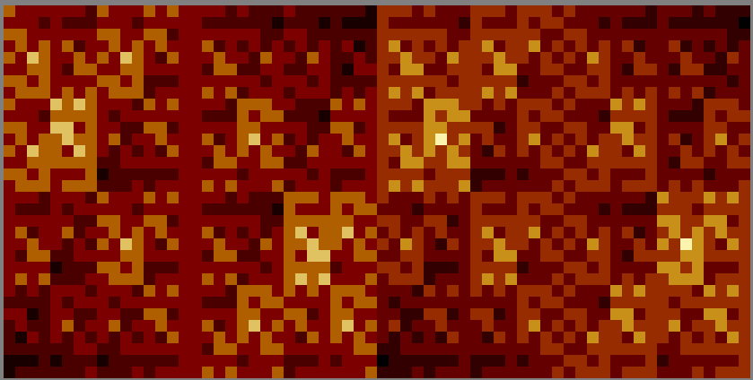
opd distribution : some mathematics…
The number of cells of a given phase shift is then given by the binomial coefﬁcients
E.g. for n = 3, we get (1 + z)³ = 1 + 3z + 3z² + z³ = 1 + z + z + z + z² + z² + z² + z³
1 cell of opd 0, 3 of λ0 /2, 3 of 2λ0 /2 and 1 of 3λ0 /2
And for a 2×32×32 chessboard : (1 + z)¹¹
1
3
2
2
1
1
0
2

Slide 15
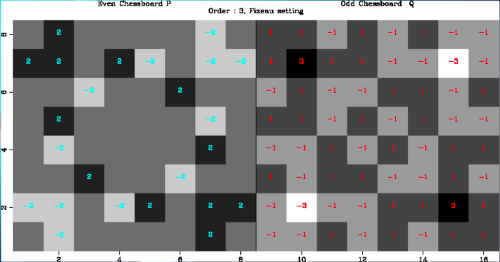
x,y-distribution of the steps
P_{r} and Q_{r} = physical arrangement of the phase shifters at order r
The cells are placed in such a way that P_{r} − Q_{r} is a ﬁnite difference differential operator of high order
Light in the focal plane is rejected outside : this improves the nulling
One can achieve this objective (Pelat, Rouan, Pickel, 2010) with the following iterative arrangement :

Slide 16
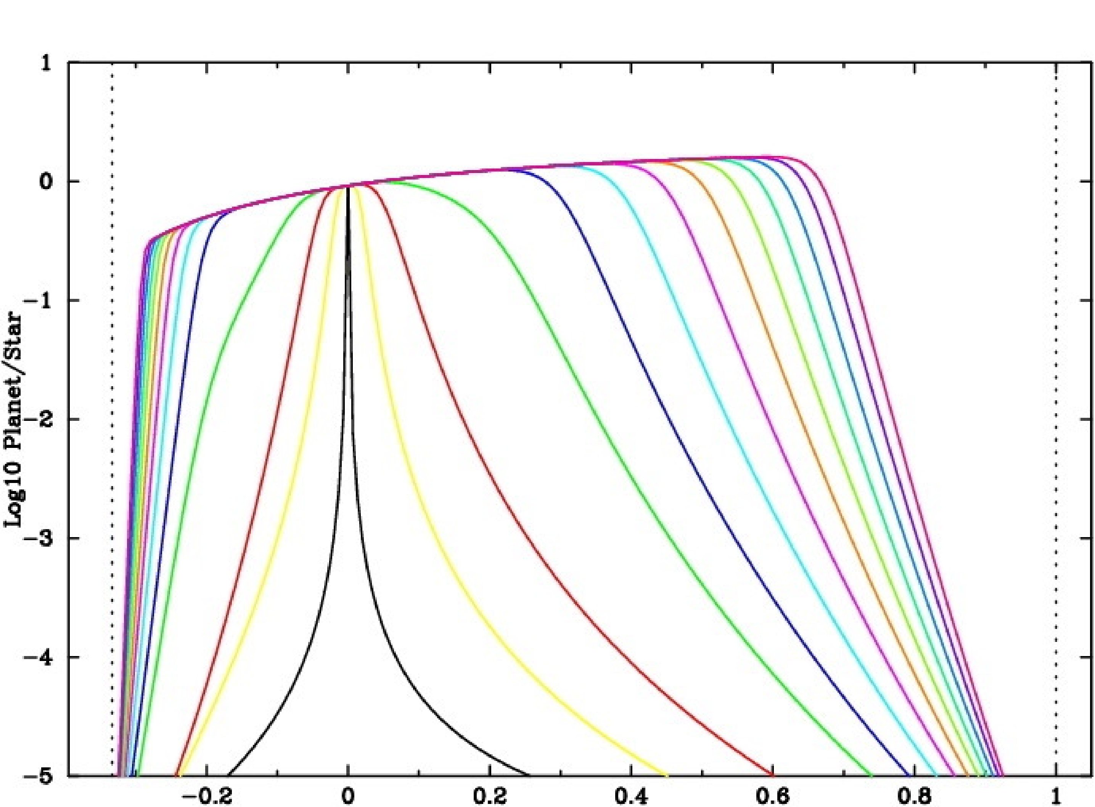
Performances of achromatization
Theoretical estimate :
Absolute max bandpass :  = 2/3 o — 2o ➜ a factor 3 in 
if 64x64 cells :  = (.65o — 1.3o) ➜ one octave.
Darwin specs (6 – 18 µm) achievable with two components
64x64
(λ − λ_{o})/λ_{o}

Slide 17
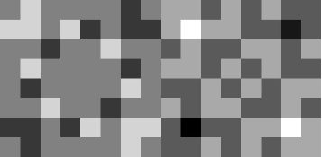
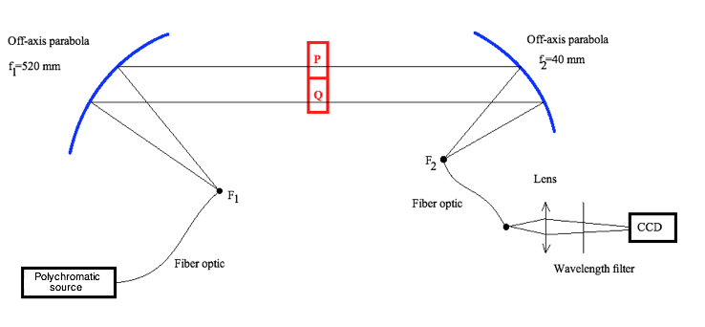
The DAMNED* test bench
Choice of visible : on-the-shelf components and detectors, no cryogeny, BUT much more severe specifications on opd accuracy
Simple design: 2 off-axis parabolas, a chessboard mask, a single-mode fiber optics
Simulates two contiguous telescopes recombined in a Fizeau scheme
The single-mode fiber is essential in the Fizeau scheme : it allows to sum the anti-symmetric amplitude and thus to make the nulling effective
Measurement : x-y scanning of the focus with the fiber optics head
* Dual Achromatic Mask Nulling Experimental Demonstrator
Single-mode fiber optics

Slide 18
The DAMNED* test bench

Slide 19
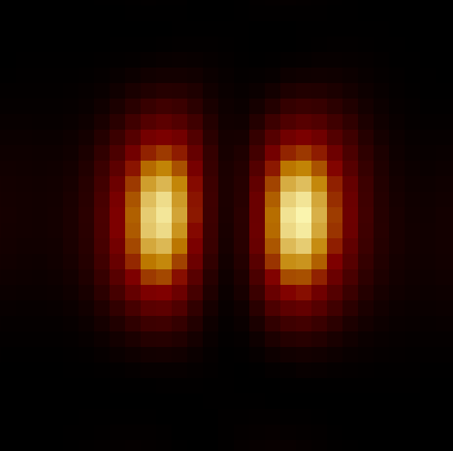
Transmissive chessboard mask
Manufactured by GEPI – Obs de Paris
2 × 8×8 cells of 600 µm size in amorphous silica, using Reactive Ion Etching
Result : typical nulling factor : 3-7 10⁻³ for broad-band filters ;
Quasi-achromatism is indeed obtained : 8 10⁻³ in the range 460-840 nm
The medium nulling factor does agree with simulations using the actual mask cell’s thickness : performances are limited by the mask’s step accuracy
Need for a better accuracy of steps thickness
Nulling valley
Scan of the focus by the fiber head

Slide 20
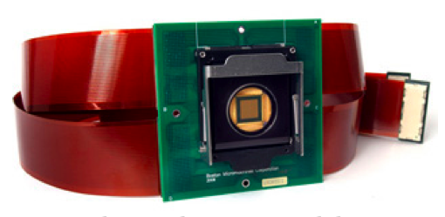
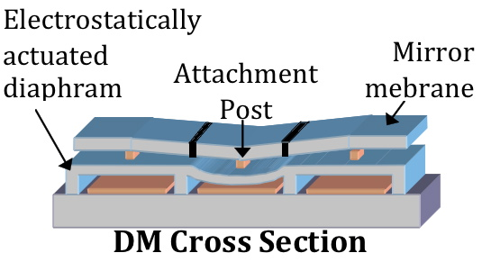
Use of a segmented AO mirror
Phase chessboard synthesized using a segmented deformable mirror:
free choice of the central wavelength
fine control of each cell’s opd
versatile way to change the XY distribution
open the door to modulation
Choice of a segmented Boston µ-machine 12 x 12 electrostatic mirror
Optical scheme adapted to work in reflection

Slide 21
DM control using strioscopy
Control of flatness using phase contrast (strioscopy) : OK
Accuracy : typically 2-3 nm
Step by step procedure to flatten the DM

Slide 22
Performances w segmented AO mirror
The parabola was no longer suited for the larger PSF (small DM) ➜ direct image of the coffee bean ➜ performance assessment less accurate
Another method : scanning by the DM at a fixed l of the source (laser)
Performances similar to the transmissive chessboard while order is lower (2 × 4×4)
Pickel et al. A&A 2013 (in press)

Slide 23
Work in progress
Present work :
Improvement of the piston control accuracy
Tuning of the optical setup
Spectroscopy for chromatic performance in a one shot
Future work : modulation between different nulling configurations to measure possible biases
Extrapolation to mid-IR : If the accuracy on piston is the same at 10 µm, a null depth of 2 10⁻⁶ would be reached on a low order (2 × 8×8) chessboard : within the Darwin specifications !

Slide 24
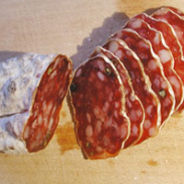
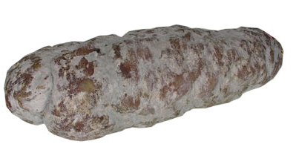
Conclusion - summary
Diophantine optics : another way of thinking problems in optics
In some cases it may bring a genuine solution
Principle of the achromatic chessboard phase shifter demonstrated in the lab, in reflection and transmission
Performances and mode of operation using a segmented deformable mirror demonstrated : brings a clear asset
Diophantine optics also brings the best solution for sharing a salami between several fellow guests….
abc bca cab bca cab abc cab abc bca bca cab

Slide 25
Thanks for your attention

