Slide 1


Science with interferometry during the last decade
  Olivier CHESNEAU
  delivered and distorted by John Monnier

Slide 2
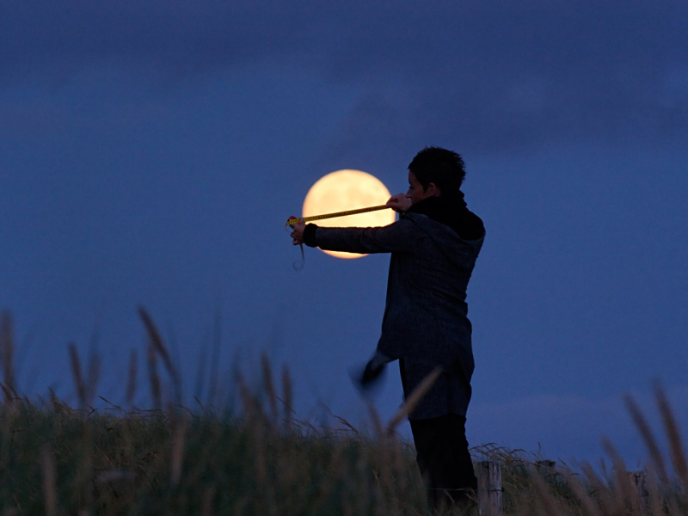
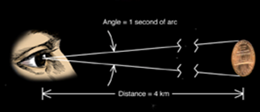


Slide 3
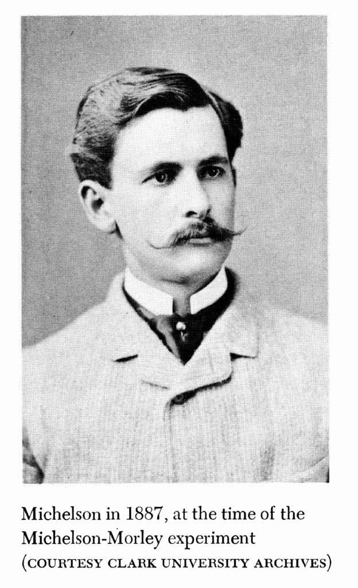
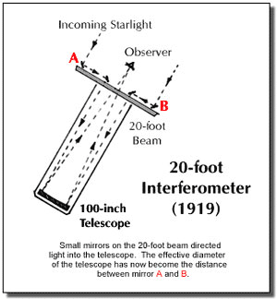
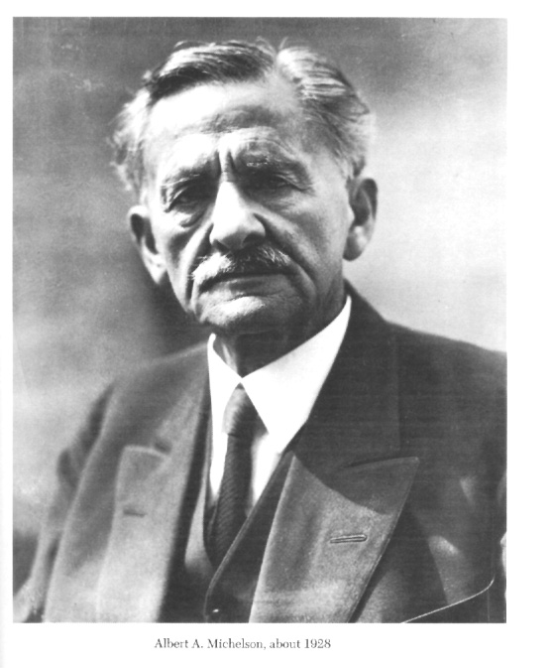
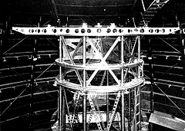
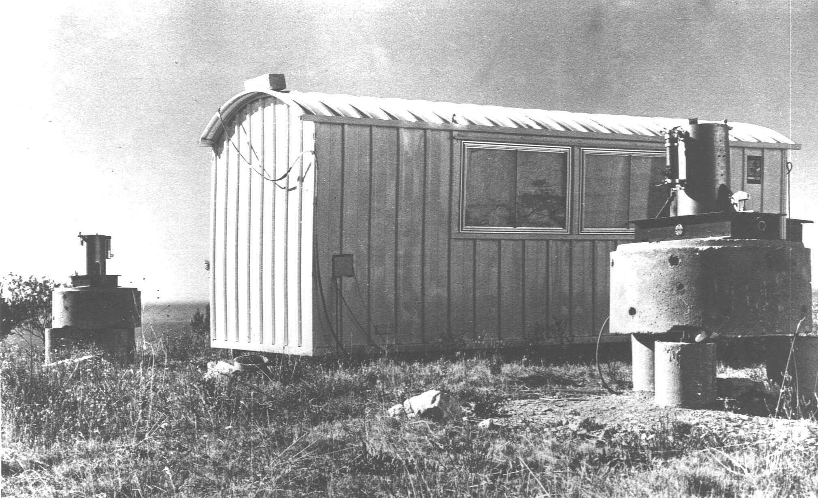
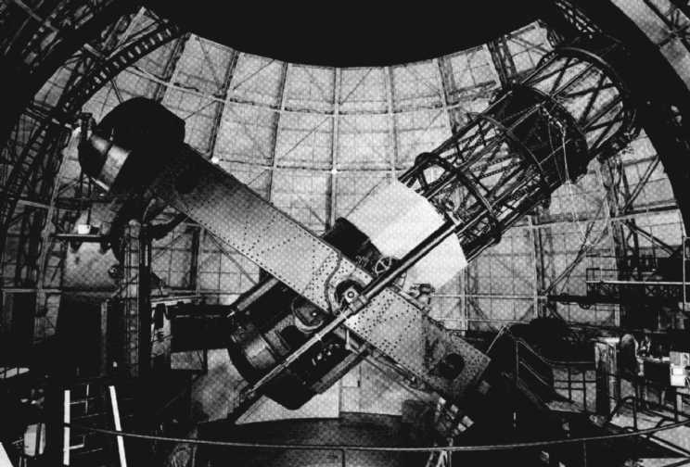
Albert A. Michelson (1852-1931)
1974: I2T

Slide 4
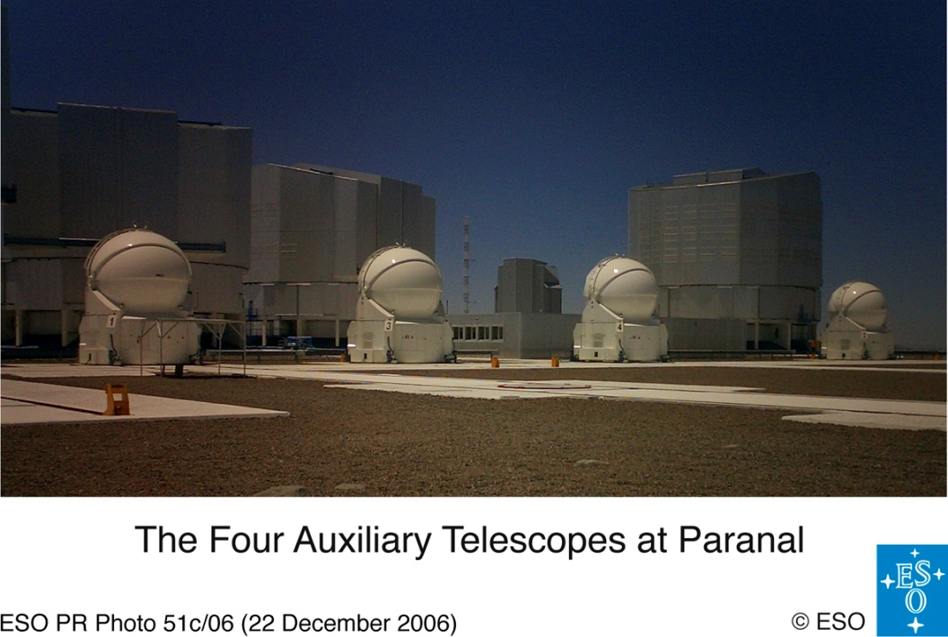
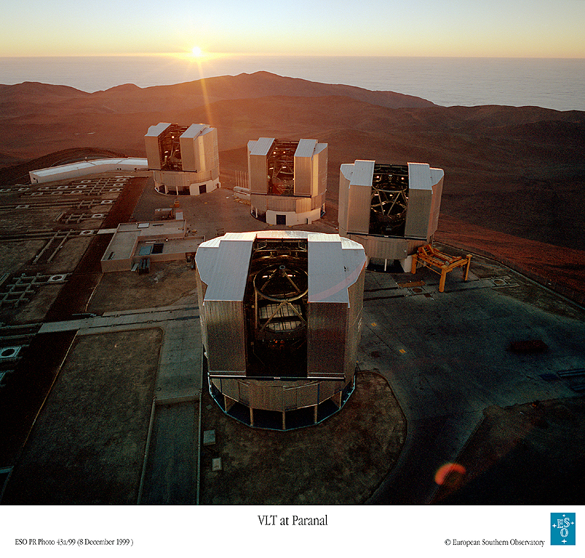
AT1
AT2
AT3
AT4
UT1
UT2
UT3
130m
MIDI
  First direct recombination (2T) in the mid-IR (8-13μm),
  resolution 10 mas
AMBER
  3T recombination (1.5-2.5μm),
  resolution 2 mas
62m
UT4

Slide 5
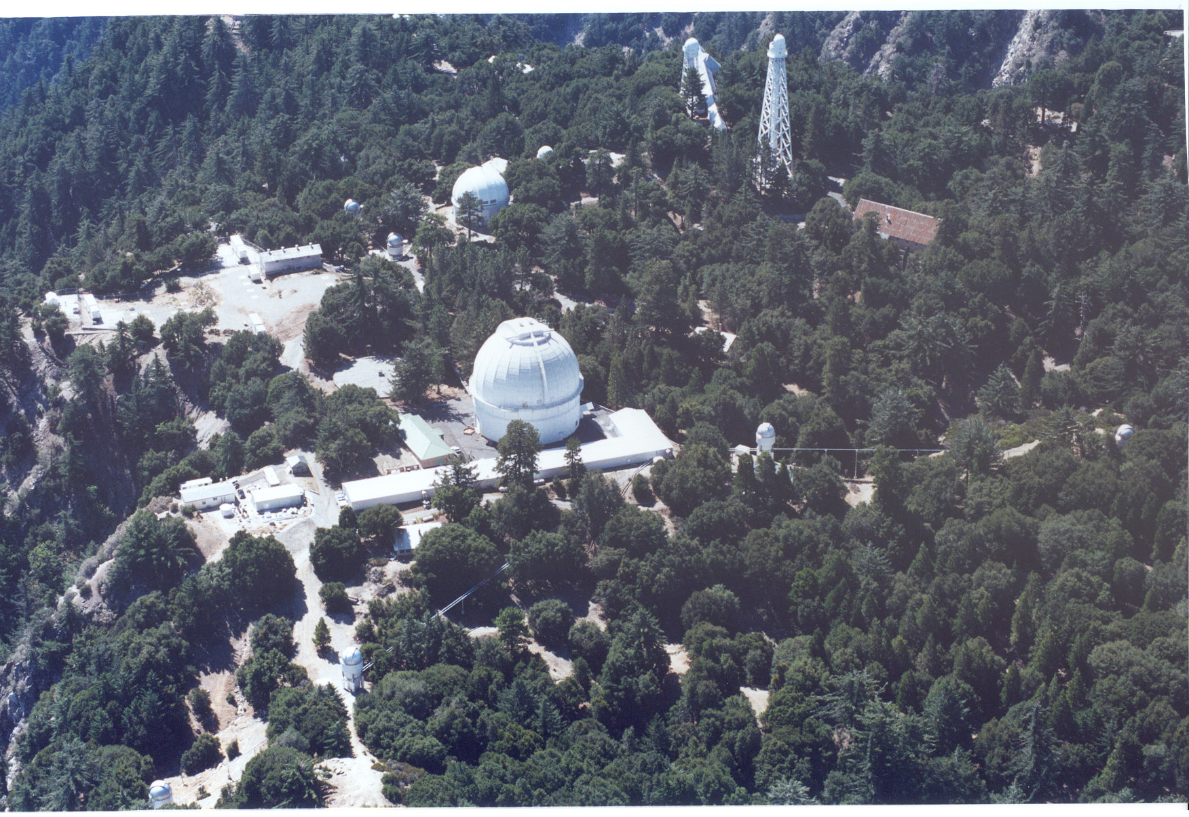
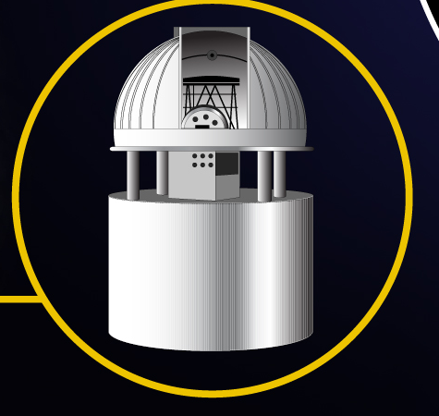
CHARA Interferometer
Georgia State University
330 meters
1m
1 milliarcsecond resolution at K band

Slide 6
Methodology
The rest of the talk is organized by astronomical topic
Papers only published from 2003-2013 were considered
Highlighted results are based mainly from the most cited papers in each area
This format means recent awesome papers do not show up
  Age before Beauty

Slide 7
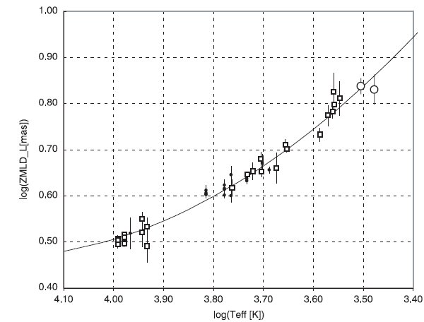
Stellar diameters
From Intensity interferometry in the blue → ~30 hot stars (1956-1976, Narrabri)
To visible / near-IR diameters and short/medium baselines→ red (super)giants (1980-2005)
→high accuracy VINCI and FLUOR (>100 stars)
Coming back to visible with now 100-330m baselines (VEGA – PAVO / CHARA)

Slide 8
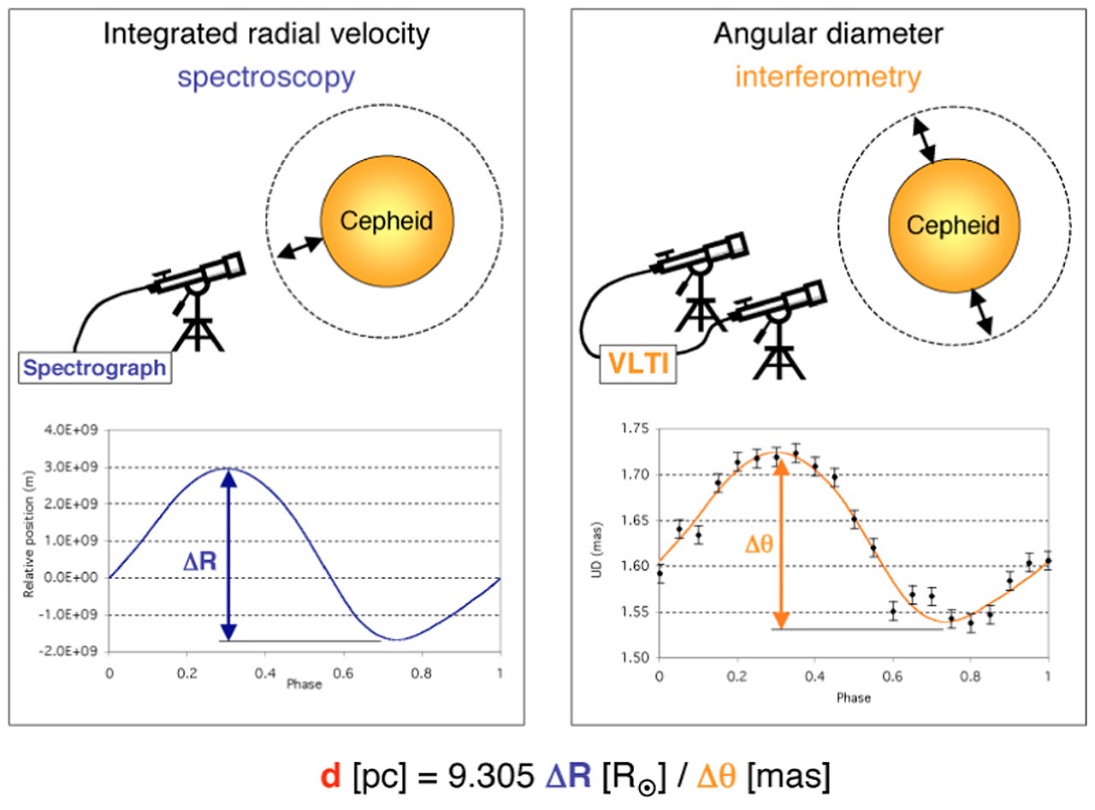
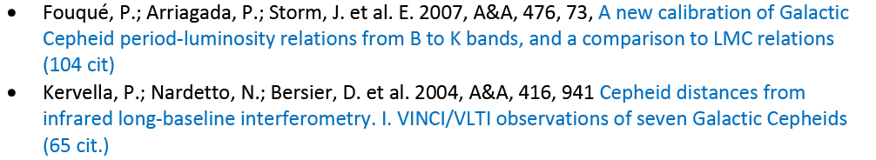
From diameters to distances

Slide 9
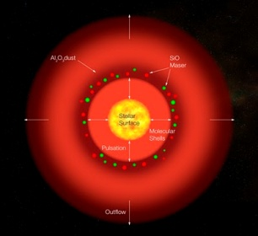
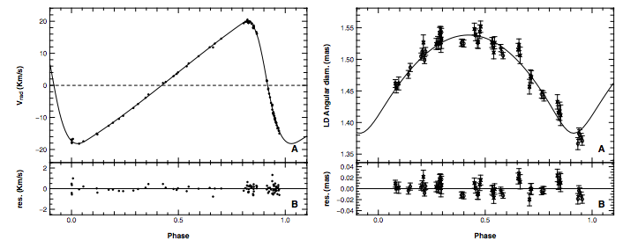
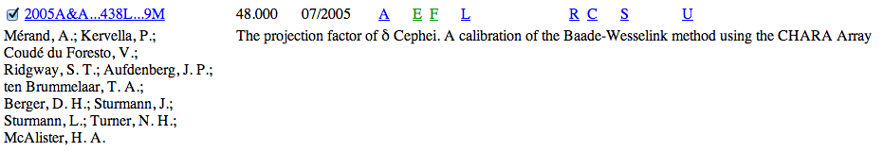
Pulsations
48 citations

Slide 10
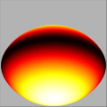
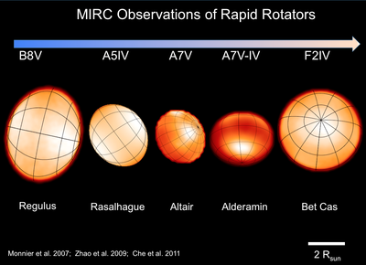
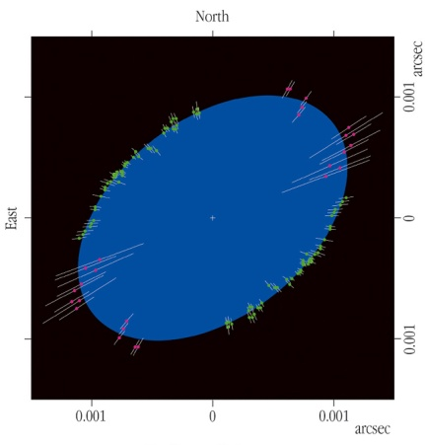
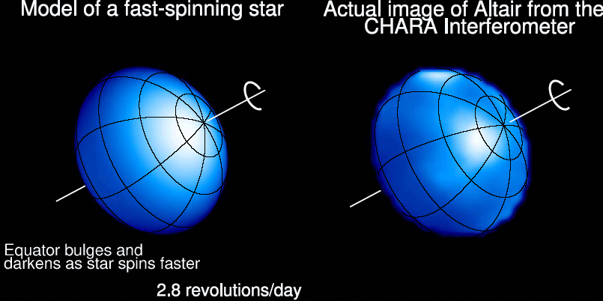
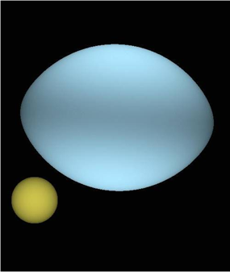
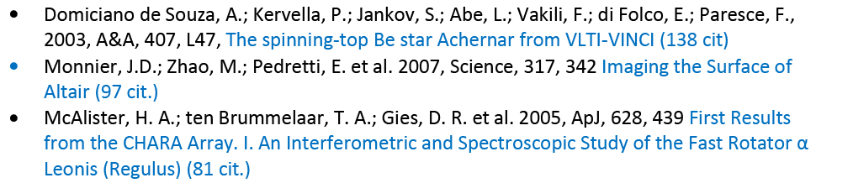
From diameters to shapes
Fast rotators
Altair,
Achernar,
Regulus
…about ~10 A-F stars
The physics of the Von Zeipel effect
Convective versus radiative layers, the Beta parameter

Slide 11
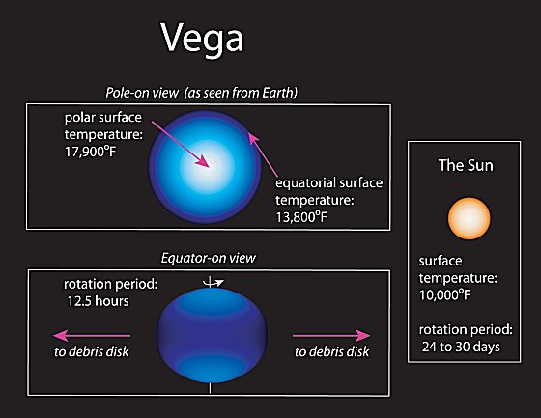
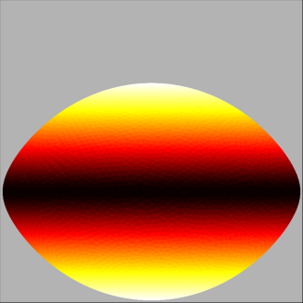
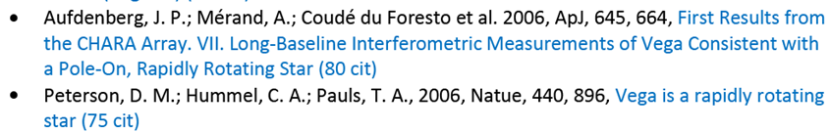
VEGA

Slide 12
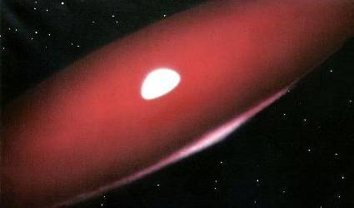
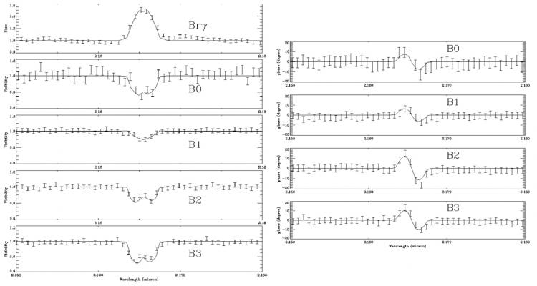
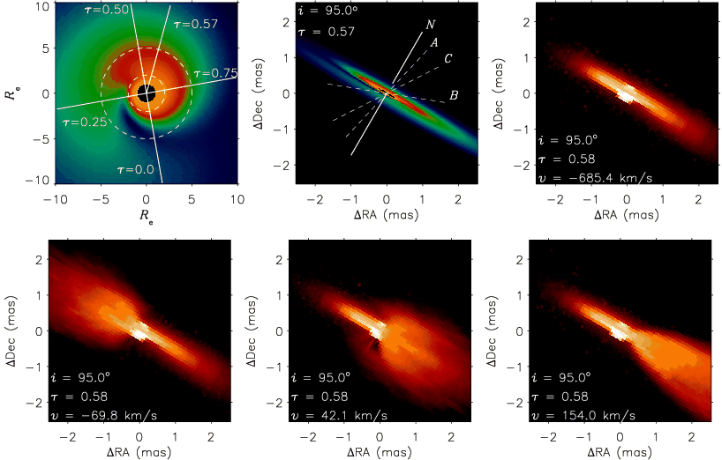
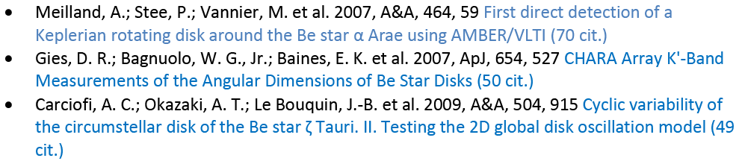
From Fast rotator to Keplerian disks

Slide 13
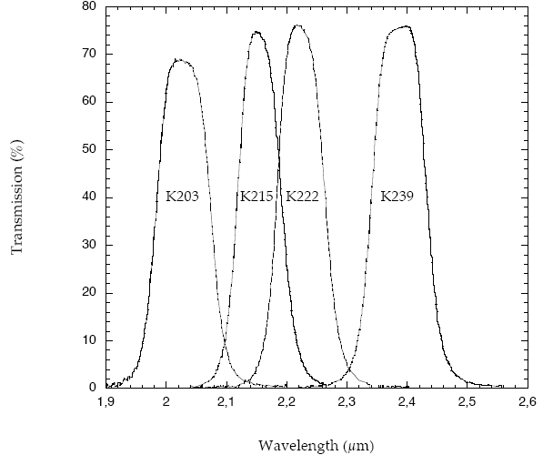
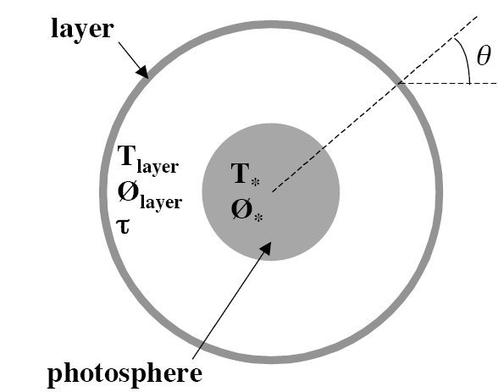
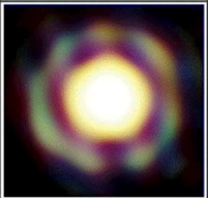
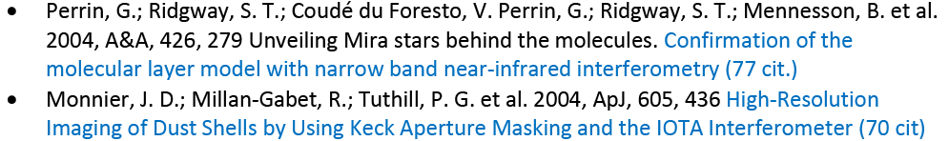
From photospheres to winds
Mass-loss from evolved stars
Dusty winds and pulsations (Mira stars),
Formation of molecules and convective motions,
Magnetically active stars and chromospheric ejections

Slide 14
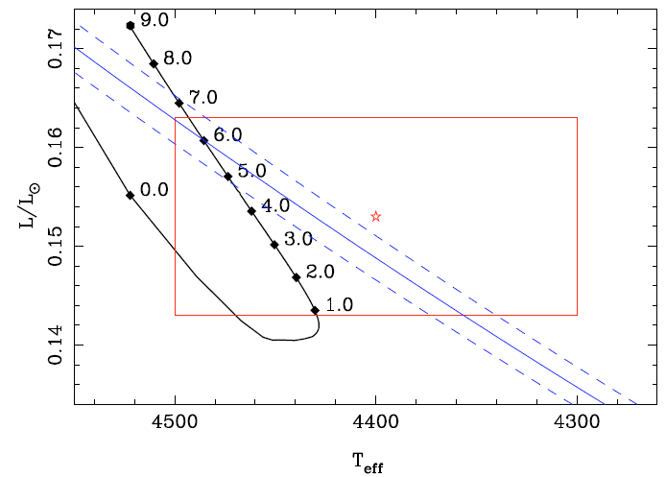
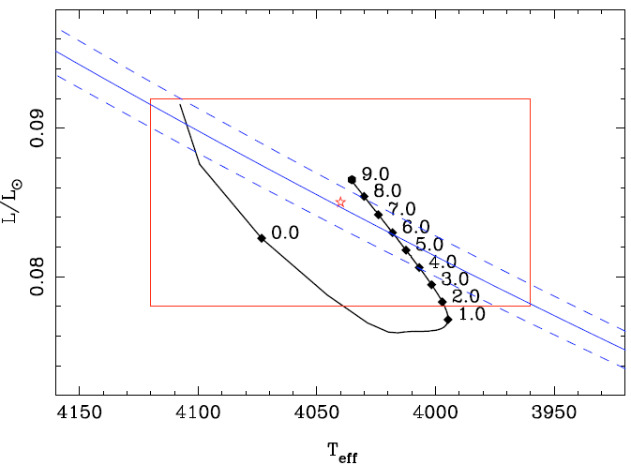
Precision Stellar Parameters
Interferometry, Stellar Evolution,
asteroseismology
Kervella et al. 2008, A&A, 488, 667

Slide 15
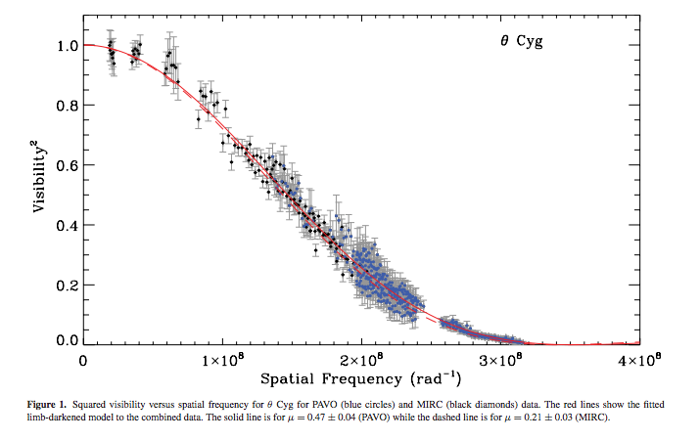
Precision Stellar Parameters
Interferometry, Stellar Evolution,
asteroseismology
White et al. 2013
CHARA: MIRC+PAVO

Slide 16
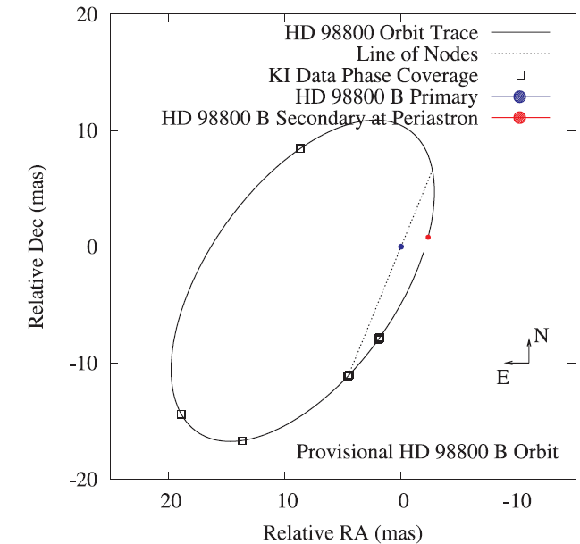
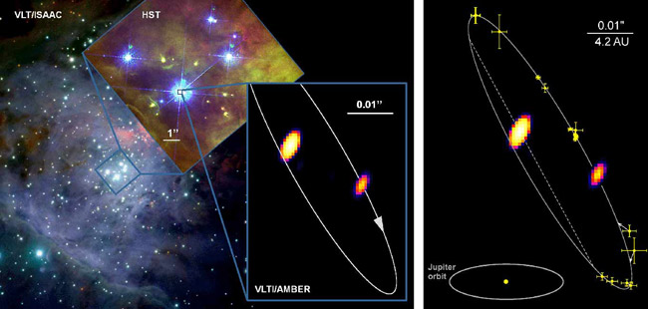
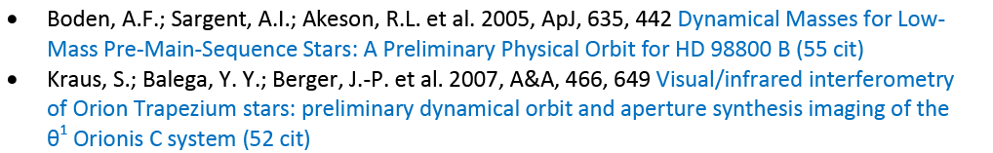
Stellar Parameters:
Masses through orbits
Visual Orbits
Coupling with spectroscopy (SB1, SB2),
Very accurate masses
P=11yr
0.7 Msol
9 Msol
38 Msol
0.58 Msol
BOTH YOUNG SYSTEMS

Slide 17
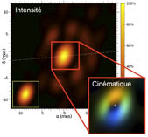
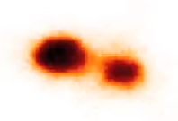
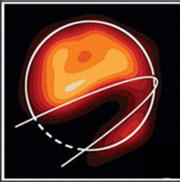
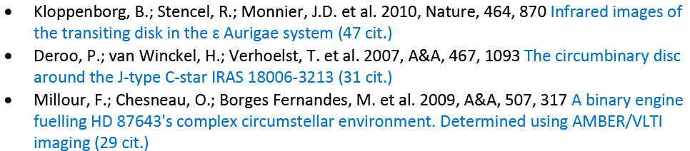
Interacting binaries
Roche-lobe overflow,
Symbiotic systems
Non conservative mass-transfer and formation circumbinary disks,
Eccentric systems and large scale eruptive events (outburst, mergers)
Wind-wind collision in massive evolved binary systems,

Slide 18
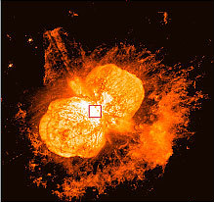
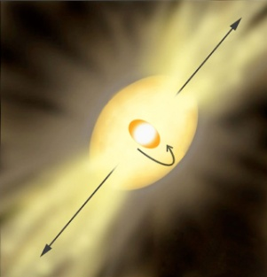
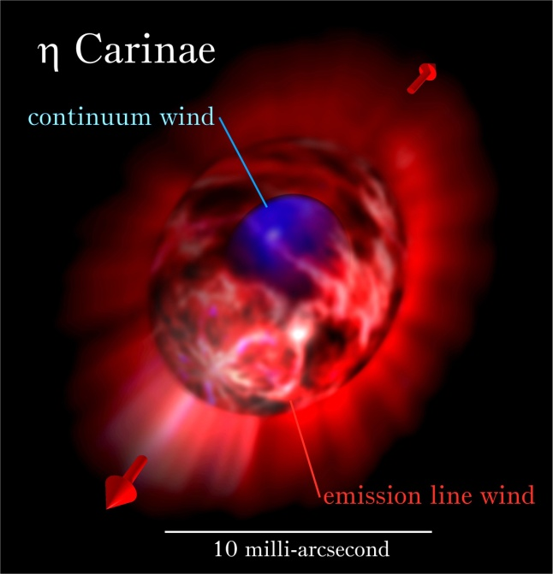
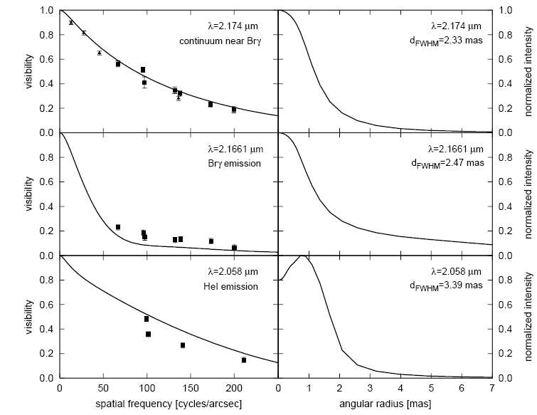
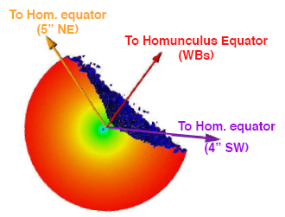
Eta Carinae
φ=0.41

Slide 19





Novae
Optical interferometry is best suited for the first month of the event
Fireball stage: Estimating the free-free content → mass ejected
Dust formation episode: physical process, link to molecules
An bipolar outburst? Or ejecta deeply influenced by common envelop stage?
→ AMBER/VLTI, VEGA/CHARA and all imagers ¨MIRC/CHARA, PIONIER/VLTI
40 mas
65 AU
Radio obs. at t=22 days
The recurrent RS Oph:
O’Brien et al. 2006,
Monnier et al. 2006
Chesneau et al. 2007,
Lane et al. 2007
Bode et al. 2008…
240 mas
380 AU
HST visible image at t=150 days
9 mas – 15 AU, t=5d

Slide 20


Young Stellar objects
Herbigs AeBe and T Tauris
Near-infrared size-luminosity diagram
mid-infrared: VLTI/MIDI
Monnier et al. 2005
Keck Interferometer Survey
Physics of the innermost regions
We have entered a “detailed modeling” phase
Van Boekel et al. 2004
Silicate features in mid-IR

Slide 21


Young Stellar objects
Massive stars
Kraus et al., Nature, 2010
Vehoff et al., A&A, 2010
Difficult sources in the optical/near-IR,
High sensitivity devices needed
Mid-IR domain best suited (but aquisition remains challenging)
→ MATISSE/VLTI and potentially GRAVITY/VLTI

Slide 22

Young Stellar objects
Had a good Decade
Akeson et al. Keck/PTI data on T Tauri Stars, TW Hya

Slide 23



Debris Disks
Large contrast between a compact, well defined stellar source and
An extended, faint emission (mostly scattered light)
→ High-precision interferometry (FLUOR/CHARA, VINCI/VLTI)

Slide 24





The solar system
Asteroids and comets
Thermal models of asteroids,
Studying the core of comets,
Asteroids and binarity
→ MIDI and MATISSE instruments

Slide 25




Extragalactic Work:
The Active Galactic Nuclei

Slide 26

AGN size-luminosity relations
Tristram & Schartmanm 2011

Slide 27
Concluding remarks
Very few papers over 100 citations (8), one (1) over 200
  Context:
    For 5 year-old astronomy papers, #1 (#100) most cited paper will have ~1000 (~125) citations
    For 10 year-old papers, #1 (#100) -> 2000 (200) citations
Survey or “synthesis” papers do better in general
  Single object papers rarely show up
# of Nature/Science papers: 6 or 7
  3 VLTI, 1 NPOI, 2-3 CHARA
  2xYSO, 1xAGN, 2xRapid rotator; 3x Imaging
Surface brightness relations, AGN and YSO papers seem to be areas having largest integrated effects
Decade of Change:
  New facilities turned-on: CHARA, VLTI
  Closures: PTI, IOTA, COAST, GI2T, Keck-I, (ISI)

Slide 28


Slide 29
backup

Slide 30



Betelgeuse
From visible to infrared
From a diameter measurement to a molecular sphere study,
Young et al. 2000, MNRAS, 315, 635
Visible, COAST
Haubois et al. 2009, A&A, 508, 923
H band, IOTA

Slide 31


Betelgeuse

Slide 32



From molecular gas motions toward convective motion studies
Ohnaka et al. 2009, 2011
AMBER / VLTI

