Slide 1
About the limiting magnitude in optical interferometry and some reseach directions to improve it
OHP 2013
Improving the performances of current and future optical interferometers
Romain G. Petrov
Laboratoire LAGRANGE (OCA-UNS-CNRS)
Avec
S. Lagarde, F. Millour, M. Vannier, S. Rakshit (LAGRANGE), T. Elhalkouj (UCA Marrakech),
Notes:
----- Notes de la réunion (30/05/13 15:11) -----
ok

Slide 2
Introduction
We need higher limiting magnitudes
We seem stalled around K=10 with the UTs
We can wait for
  detectors to improve ?
  And use off-axis tracking in special cases ?
  A new concept or technology ?
  Or wonder if fainter targets will not be too small ?
But we can also progress on:
Incoherent and coherent data processing
Cophasing and coherencing
Off axis tracking, sky coverage and isopistonic angle
…
There are science programs at higher magnitudes,
for existing and future interferometers!

Slide 3
Current « common sense »
We process frame by frame and average the results
  Or we average coherent frames
    In both cases, this has the performance of a coherent processing
The limiting magnitude is set by the capacity to detect fringes in one frame (~coherence time), or by the Fringe Tracker
The limiting magnitude of any higher spectral resolution is set by the Fringe Tracker limit
Fringe Tracker on sources fainter than K=10-11 needs is very uncertain.
Fainter sources would need much longer baselines.

Slide 4
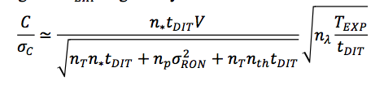
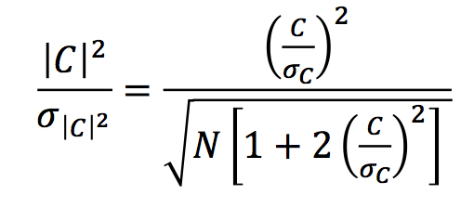
Coherent, incoherent, intermediate
Coherent integration of short exposures
  Works weel when SNR>1
Incoherent integration
  When SNR_{frame}<1,
    varies like SNR² n^{1/2}
  Should be very innefficient
  BUT

Slide 5
Blind mode observing and 2DFT processing
K=4
K=8.5
K=10
Notes:
Courbes de SNR, notamment pour 4 telescopes.

Slide 6
Fringe peak monitoring and piston tracking

Slide 7
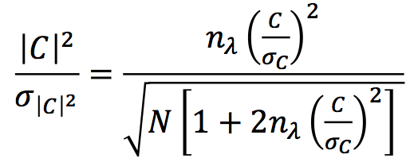
<|2DFT|²> processing
<|2DFT|²> processing is:
  A coherent addition of all spectral channels
  An incoherent addition of 2D power or cross-spectra

Slide 8
TF2D measurement of complex coherent flux
FT_{2D}( ) * FT_{2D}( )* =>
Cross spectrum at σ yields:
Where Ω^{ij}(σ) is the “object” to be measured and calibrated:
if we have the Exact measure of piston p_{a}:
Notes:
On peut passer rapidement… Il y a des estimateurs de visibilité et de phase différentielle qui se moyennent

Slide 9
3C273 results
Differential visibility
The BLR gas extends beyond the inner dust rim
Differential phase
  Φ=0±1°

Slide 10
Résultat MR à K~10
Résolution de la BLR du Quasar 3C273
Distribution d’intensité de la BLR dans chaque canal spectral
North
1
0
La BLR est plus étendue que le bord intérieur du tore de poussière
Ce n’est pas un disque fin
  Angle d’ouverture >90°
Masse du trou noir central:
65±10 10⁸ M_{sol}
(>>Kaspi 2000: 2 10⁸ M_{sol})
Petrov et al., SPIE 2012 et Petrov et al., 2013
-1
-4000 Km/s
-3000 Km/s
-2000 Km/s
1
milliarcseconds
East
0
-1
1000 Km/s
0 Km/s
-1000 Km/s
1
0
-1
2000 Km/s
3000 Km/s
4000 Km/s
-1
0
1
-1
0
1
-1
0
1
milliarcseconds

Slide 11
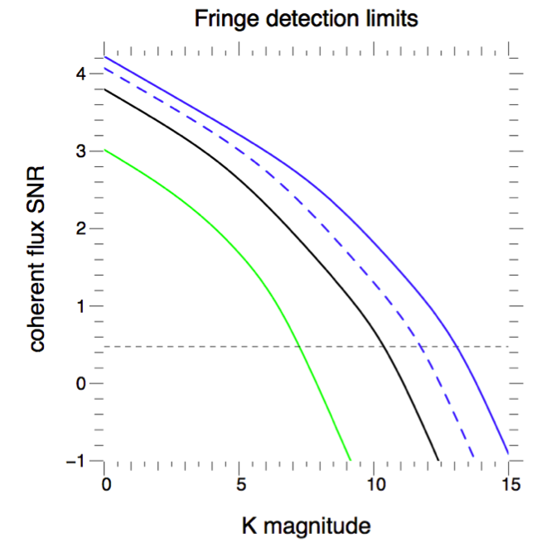
performance of <|2DFT|²> processing
With AMBER and its current
detector: Ron=11e⁻

Slide 12
Optimizing spectro-interferometry for 2DFT
K=4
K=8.5
K=10
Notes:
Courbes de SNR, notamment pour 4 telescopes.

Slide 13
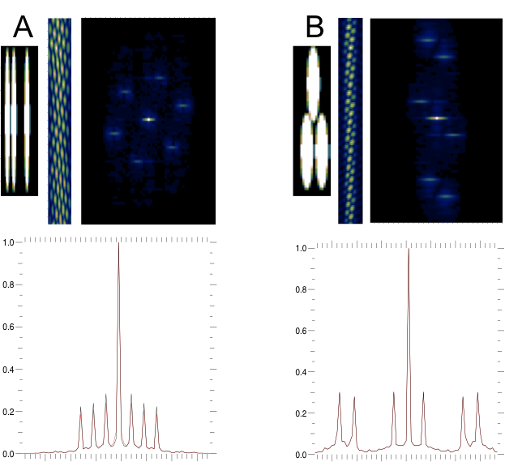
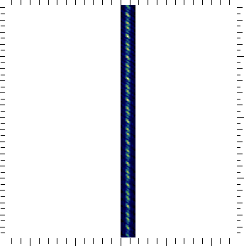
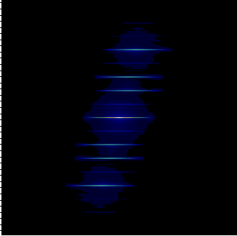
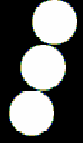
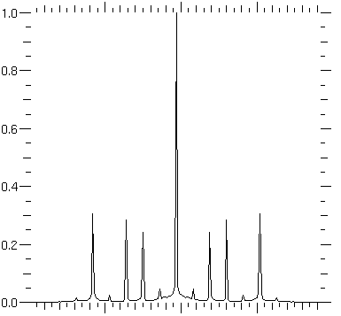
Saving pixels in spectro-interferometry
32 pixels/channel
12 pixels/channel
4 pixels/channel

Slide 14
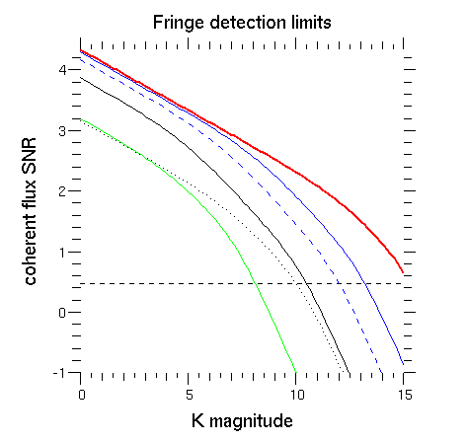
performance of <|2DFT|²> processing
1: current standard AMBER processing, MR=1500
2: <|2DFT|²> processing with current AMBER
3: <|2DFT|²> processing with improved AMBER but current detector (11e⁻)
4: <|2DFT|²> processing with new instrument and SELEX detector (3e⁻)
4
1
2
3

Slide 15
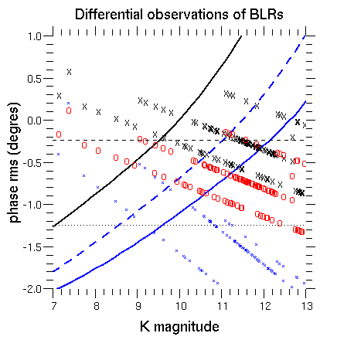
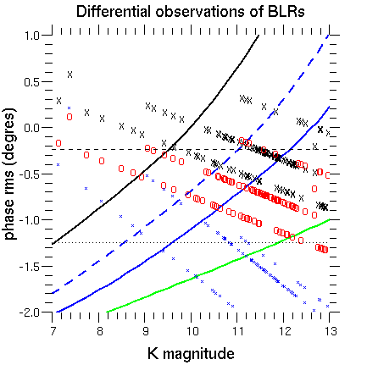
An observing program for high magnitudes
X : differential phase from R_{in} diameter
(IR reverberation mapping, extrapolated)
O : differential phase from RM radius
(H_{β} RM extrapolated)
* : differential visibility from R_{in} and R_{BLR}<<R_{in}

Slide 16
Hierarchical cophasing
Pair-wise: each 2T fringe tracker receives 2*(1/(N_{T}-1)) photons
All in one: noise
(N_{T}*(n*+n_{th})+αN_{B}²σ_{R}²)^{0.5} on n*V peaks.
Hierarchical: each FT receives > 2(n*/2) photons
Global SNR increases with N_{T}
Sensitivity limit set by size of unit telescope
(Elhalkouj, 2006, 2008)
Notes:
On peut envisager de sauter ça

Slide 17
Dream cophasing
T₁
T₂
When T1 and T2 cophased, « all » flux is transmitted.
The beam C behaves like a spatial filtered beam from a cophased telescope
When T1 and T2 are out of phase, the flux in A, B and C allows to compute the piston
All the flux from T1 and T2 is used to cophase them
A
B
C
Notes:
Il faudrait mettre la dessus les plots A(δελτα,αλπηα), Β(δελτα,αλπηα), Χ(δελτα,αλπηα).

Slide 18
Dream cophasing
⁰T₁
⁰T₂
⁰T₃
⁰T₄
Each cophased pair behaves as a single telescope
⁰A₁₂
⁰B₁₂
⁰A₃₄
⁰B₃₄
⁰C₁₂=¹T₁
⁰C₃₄=¹T₂
¹A₁₂
¹B₁₂
¹C₁₂
Notes:
Il faudrait mettre la dessus les plots A(δελτα,αλπηα), Β(δελτα,αλπηα), Χ(δελτα,αλπηα).

Slide 19
Dream Cophasing
For the first level, the SNR is the maximun one for 2T
For the lower pairs, the SNR increases
Each FT drives one delay line
²A₁₂ , ²B₁₂ , ²C₁₂ → ²δ₁₂ , ¹C₁₂ , ¹C₃₄
^{i}A_{lk} , ^{i}B_{lk} , ^{i}C_{lk} → ^{i}δ_{lk} , ^{i-1}C_{lk} , ^{i-1}C_{lk}
……
L₁= 0
L₂= L₁+⁰δ₁₂
L₃= ¹δ₁₂
L₄= L₃+⁰δ₃₄
L₅= ²δ₁₂
L₆= L₅+¹δ₃₄
L₇= L₆+⁰δ₆₇
⁰T₁
⁰T₂
⁰T₃
⁰T₄
⁰T₅
⁰T₆
⁰T₇
⁰A₁₂
⁰B₁₂
⁰A₃₄
⁰B₃₄
⁰A₆₇
⁰B₆₇
¹T₁=⁰C₁₂
¹T₂=⁰C₃₄
¹T₃=⁰T₅
¹T₄=⁰C₆₇
¹A₁₂
¹B₁₂
¹A₃₄
¹B₃₄
²T₁=¹C₁₂
²T₂=¹C₃₄
²A₁₂
²B₁₂
²C₁₂
Notes:
Le mode de calcul entraîne une propagation de bruit à partir de ²C₁₂, qui est aussi le signal à plus fort RSB. Même si on perdu tous les cophasage, le dernier FS reçoit au moins la moitié de tous les flux, mais est ce que c’est un flux cohérent ? Tel quel, ou avec un filtre spatial supplémentaire?
Par ailleurs, que se passe t’il quand on injecte un faisceau plus ou moins incohérent dans un filtre spatial? En principe une perte de taux de couplage (c’est à dire que le flux va en A ou B).
Peut on dire que ce qui est transmis par une grille est la partie cohérente du flux en amont.
Il faudra un correcteur de dispersion atmosphérique pour chaque faisceau

Slide 20
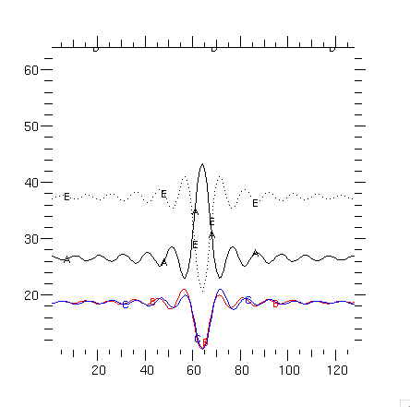
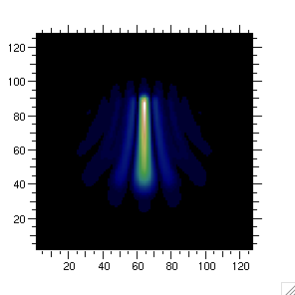
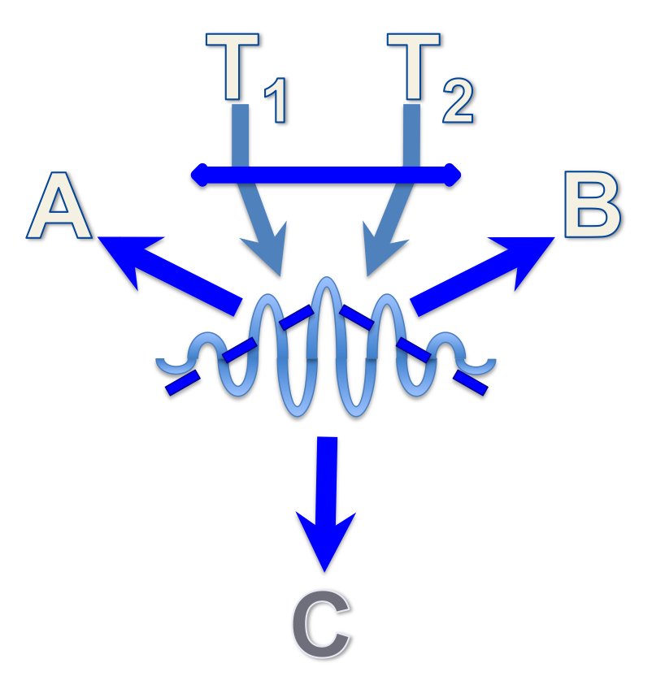
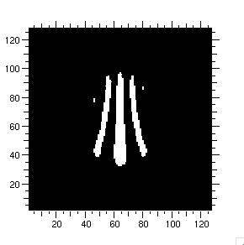
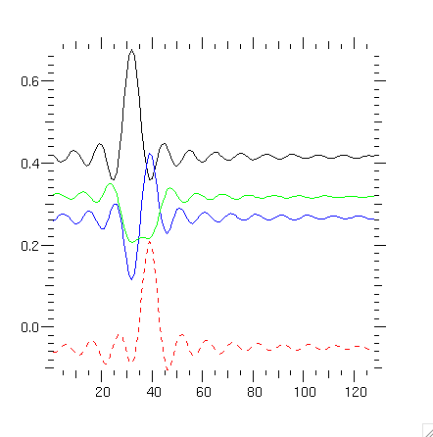
Could it work?
C (68%)
A
B
microns
C
A
A
B
B
B-A
microns
Notes:
Il faudrait mettre la dessus les plots A(δελτα,αλπηα), Β(δελτα,αλπηα), Χ(δελτα,αλπηα).

Slide 21
And after ?
Cophasing at K>13, provides a ~1% sky coverage (in galactic pole direction) for off-axis guiding
Cophasing at K>13, in Dôme C, provides a 10% to 30% in Dôme C, with 2-3 class telescopes (from the ground)
  Dôme C is dead, but Dôme A …
A tomography of the local wavefront, from laser guide stars or from natural stars, could allow to compute the exact contribution of each telescope to the piston error and hence increase the (synthetic) isopistonic domain…
What about off-axis coherencing ?
  Stabilizing the piston within 2 μm would allow 2DFT processing with spectral resolution <100
    Almost LR; K>16…
What about 3DFT ?
  It would replace the coherence time of the piston, by this of its derivative
…

Slide 22
Conclusion
We need an active research on limiting magnitude in interferometry
  Optimization of parameters from better atmospheric optics and interferometer models.
  How far can we push 2DFT processing
    How could it apply to GRAVITY, and MATISSE
  What is the minimum spectral resolution allowing this mode
  How to push the limits for cophasing
  How to increase the isopistonic domain
  What off-axis coherencing makes sense
  What is the sky coverage for off axis cophasing
  What science program and what baselines for K>13
  …

