Slide 1

Spectrally resolved frequency comb interferometry
Steven van den Berg
International Colloquium Observatoire de Haute Provence
23-27 September 2013

Slide 2
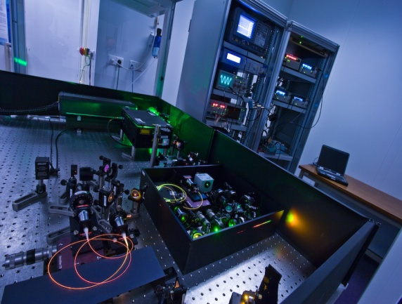
Outline
  Introduction to VSL
  Introduction to the frequency comb
  Distance determination based on:
    cross-correlation measurement
    spectral/dispersive interferometry
    Proof of principle: high resolution spectral interferometry with a VIPA spectrometer
  Conclusions and future prospects

Slide 3
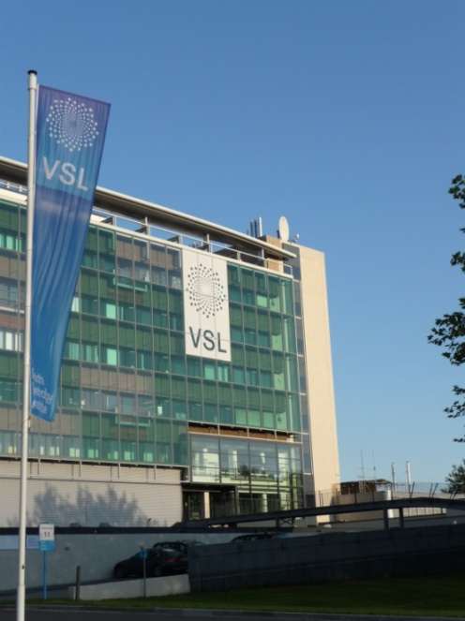
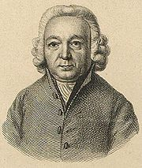
About VSL
VSL is the national metrology institute of the Netherlands, located in Delft
Private company with public task
Turnover: partly government, partly market
About 90 FTE
ISO 17025 accredited
VSL is named after Jean Henri van Swinden, who contributed to the development of the meter (end 18th century)
Jean Henri van Swinden

Slide 4
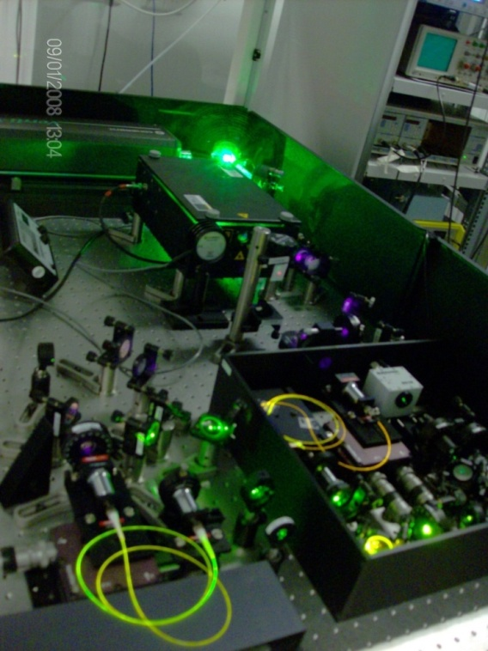
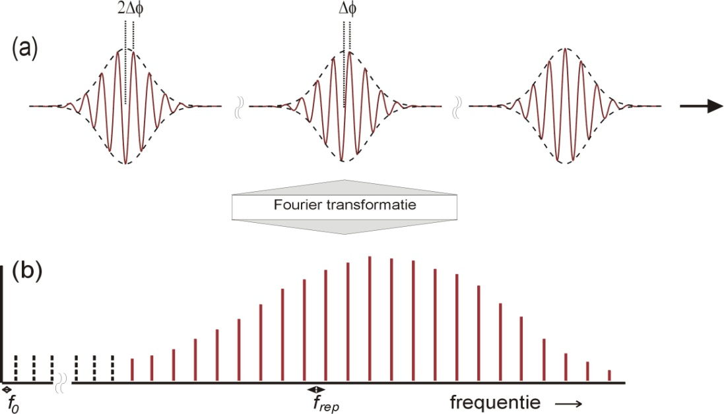
Principle of the frequency comb
A frequency comb is the spectrum of a pulsed laser:
1/f_{rep}
laser
f_{rep}: repetition frequency
f₀ = φ/2π • f_{rep}: offset frequentie

Slide 5
Pulsed lasers/frequency combs
Many frequencies / ‘modes’ oscillating at same time, phase locked/mode locked:
L
Frequency difference subsequent resonant modes:
L = 15 cm Δf = 1 GHz

Slide 6
Pulsed lasers
And so on, for example 30 waves:
SUM

Slide 7
Properties of the frequency comb
Offset frequency and repetition frequency are stabilized to an atomic clock and known on comparable level of accuracy
The (vacuum) pulse-to-pulse distance is known on same level.
About 10 thousand phase-locked frequencies covering the spectral range from 808-828 nm contribute to the laser output (VSL comb)
Tool for direct calibration of optical frequency standards with respect to SI second (using spectral broadening in microstructured fiber)

Slide 8
Properties of the frequency comb
Properties of interest for distance measurement:
  Stabilized pulse to pulse distance, acting as a ruler for distance measurement
  Wide spectrum, allowing for spectral interferometry
  Presence of thousands of individual and stabilized laser modes, available for homodyne interferometry
1/f_{rep}
  The pulse train can be viewed as a superposition of phase-locked wavelengths.

Slide 9
Why comb based distance measurement?
    Absolute distance measurement with high accuracy combined with long range of nonambiguity.
      Non-ambiguity range: e.g. 15 cm vs < 500 nm for single wavelength interferometry.
    Prospect of very long range applications (>1000 km) due to long coherence length
    Direct traceability to SI second
    Potential applications
      Distance measurement between satellites
      Surveying applications or large scale structures
      Refractive index measurement

Slide 10
Application to distance measurement
Proposed/demonstrated schemes:
  Comb as a high frequency modulator (Minoshima)
  Distance measurement from cross-correlation scheme (Ye, Cui et al)
  Spectral/dispersive interferometry (Yoo/Kim, Cui et al)
  Heterodyne interferometry with slightly detuned combs (Coddington)
This talk
  Distance measurement based on cross correlation
  Distance measurement based on spectral interferometry
  Homodyne interferometry with a mode-resolved frequency comb

Slide 11
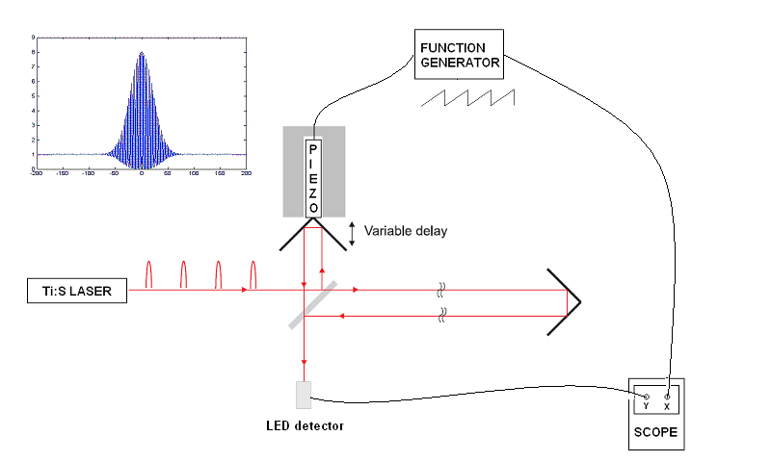
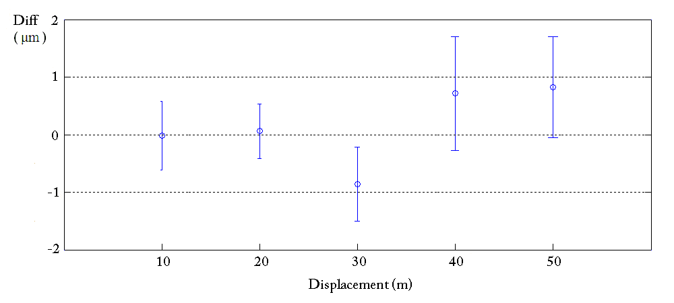

Distance measurement based on cross-correlation
1st or 2nd order correlation
Cross-correlation between pulses for path length difference equal to multiple of interpulse-distance.
Apply model pulse propagation in air
Compare to helium-neon laserinterferometer
Agreement up to 50 m within 1 μm
M. Cui, M.G. Zeitouny, N. Bhattacharya, S.A. van den Berg, H.P. Urbach and J.J.M. Braat, Opt. Lett. 34, No.13 (2009)

Slide 12
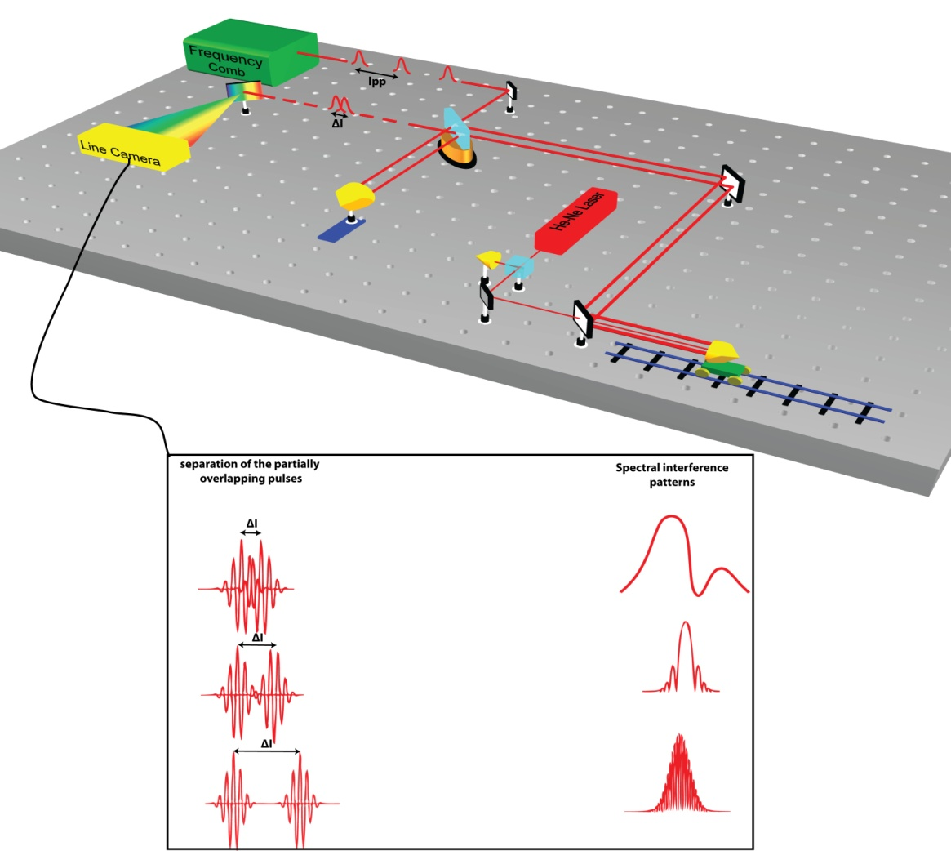
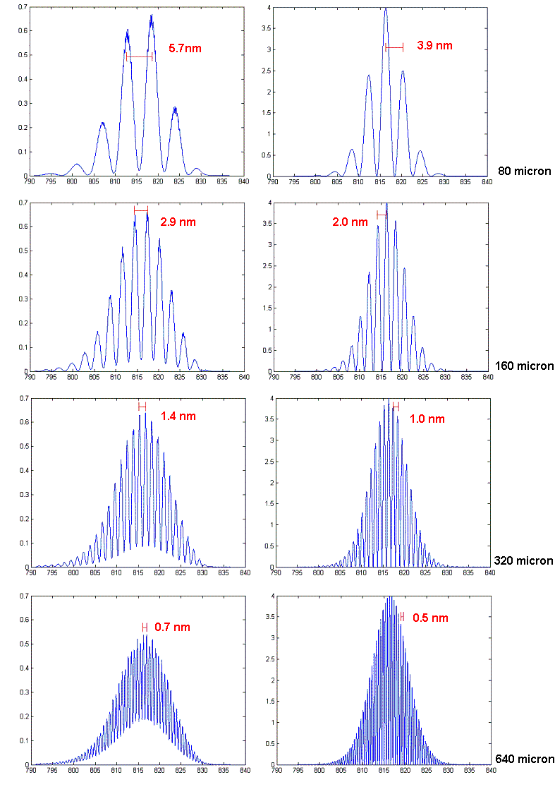
Distance measurement based on spectral interferometry
Distance determined from unwrapped phase of spectral interference pattern
80 μm
320 μm
Agreement at 50 m distance within 1 μm, uncertainty 1 μm
M. Cui, M.G. Zeitouny, N. Bhattacharya, S.A. van den Berg and H.P. Urbach, Optics Express, Vol. 19 Issue 7, pp. 6549-6562 (2011).

Slide 13
Distance measurement based on spectral interferometry
  Very good results with spectral interferometry, but with some limitations:
    Applicable to restricted range because of limited resolution of the spectrometer
    Calibration of wavelength scale needed by using known displacement
  Ultimate goal: ability to resolve (and identify) individual comb modes
    Allows for measurement of an arbitrary distance, not only close to multiples of L_{pp}.
    No indirect calibration needed using known displacement
    Not only spectral interferometry but also homodyne multi-wavelength interferometry possible.

Slide 14
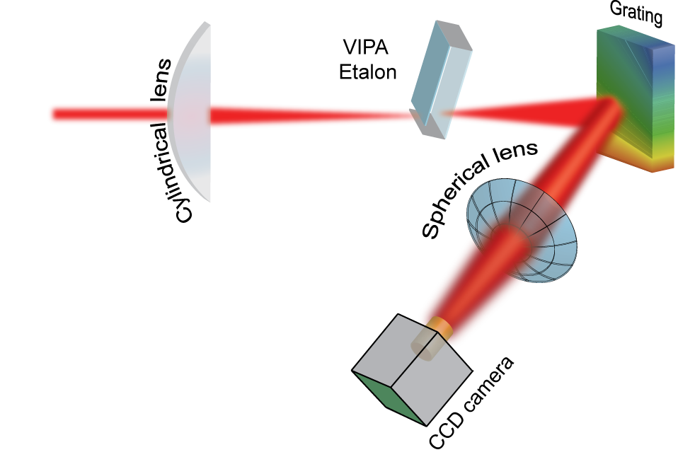
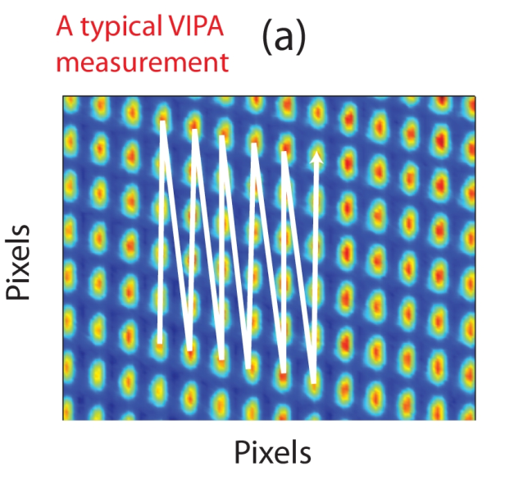
Unwrapping the comb
  Virtually imaged phase array (VIPA) to create fine angular dispersion (vertical plane)
Grating for rough angular dispersion (horizontal plane)
Imaging on CCD camera
Stitching of vertical lines to get full
frequency scale

Slide 15

Unwrapping the comb
Comb lines separated to individual dots
Repetition rate: 1 GHz
808-828 nm dispersed in about 9000 unique dots
VIPA FSR: 50 GHz

Slide 16
ZOOM

Slide 17
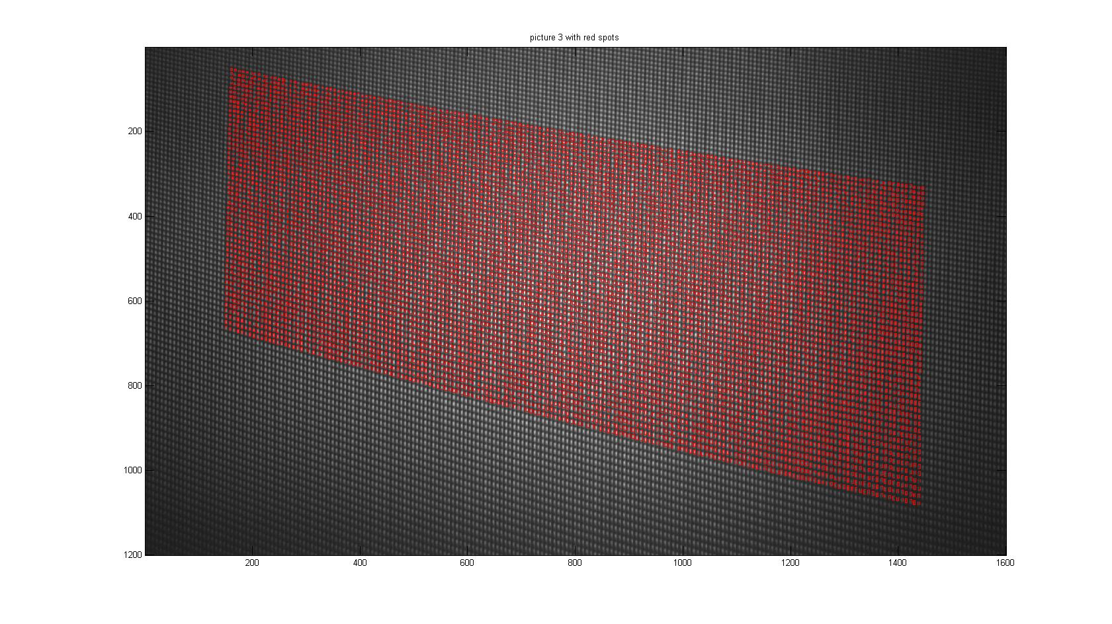
Calibration issue: which line is which?
Or: how to sort dots in right order along a frequency axis
Use several wavelengths generated with OPO, propagating along same path as comb as markers for scale calibration
Wavelength measured with wavemeter on 10⁻⁷ level simultaneously
Identify set of unique dots (laser modes), that together form wavelength scale

Slide 18
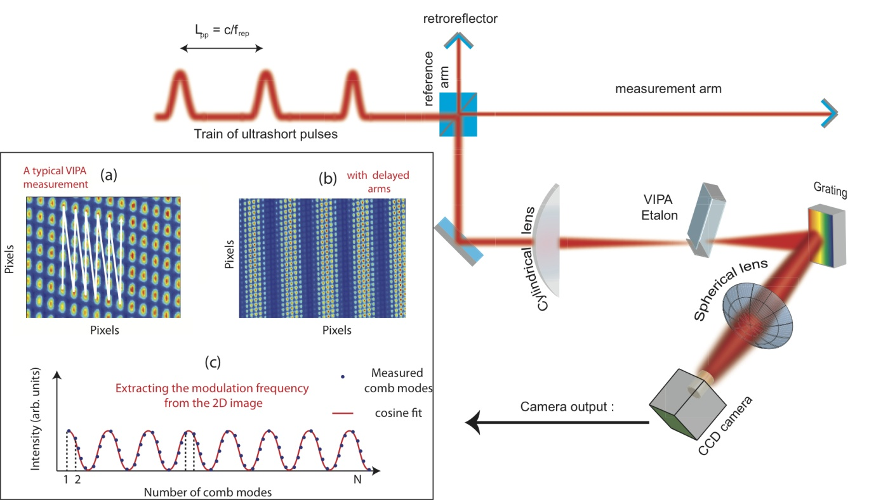
Setup for distance measurement with a VIPA spectrometer
Analyze interferometer output with a VIPA spectrometer for mode resolved spectral interferometry
Short distance for proof of principle

Slide 19
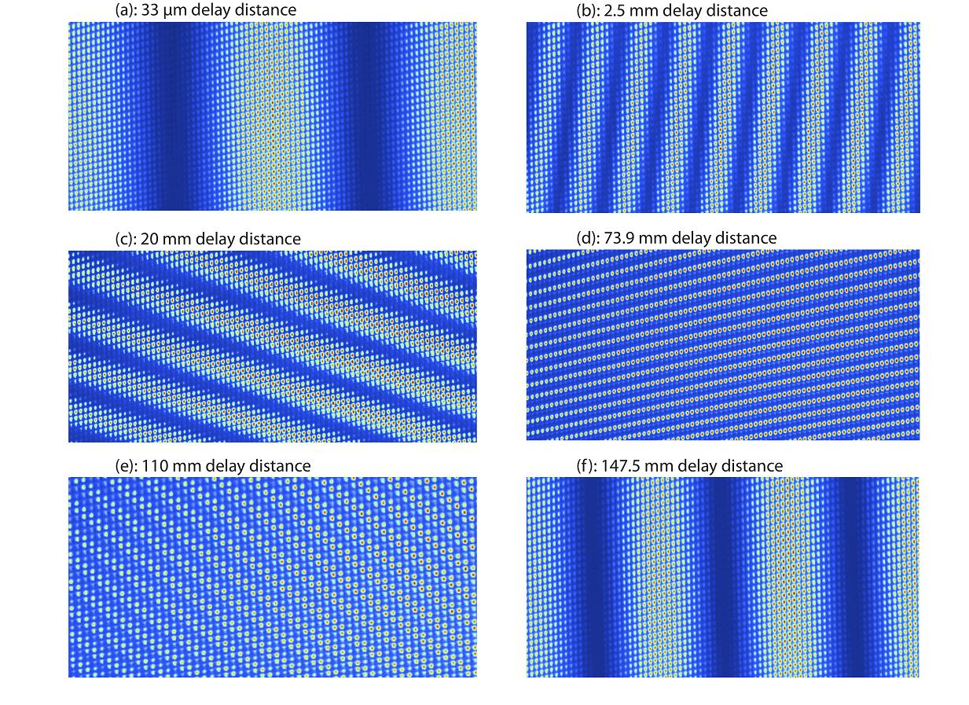
Comb interference at various delays

Slide 20
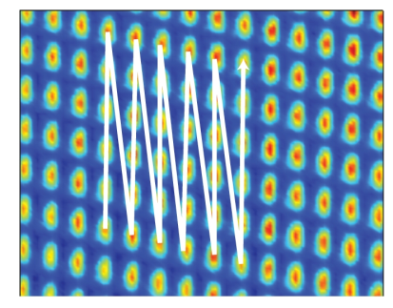
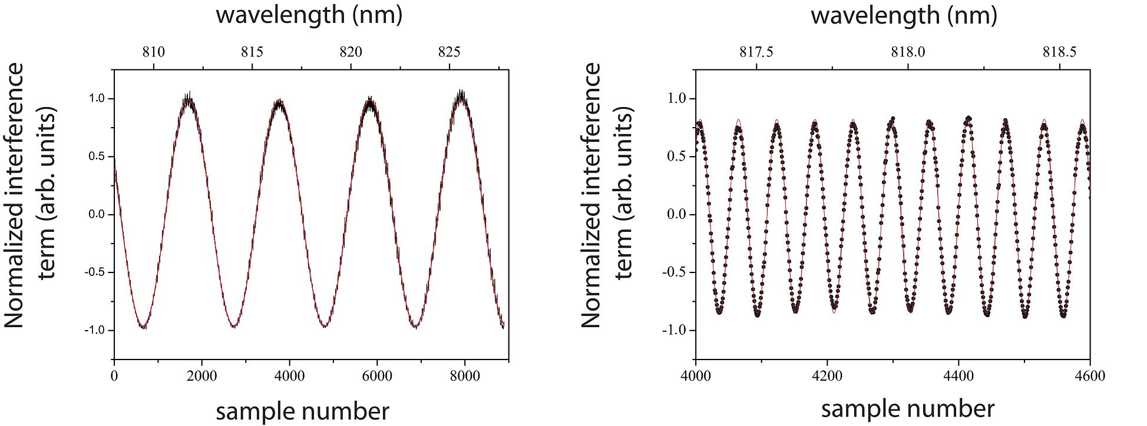
Reconstructed comb spectrum
Stitching: 50 dots per vertical line and about 180 lines to get frequency scale with ~9000 comb modes
Delay: 33 μm
Delay: 2.5 mm

Slide 21
1) Distance determination from spectral interferometry
Distance is derived from phase change as function of wavelength
Interference
L: displacement from zero delay
n: refractive index of air
λ: wavelength
f: frequency
c: speed of light in vacuum
Phase
Determine L from
with dφ/df determined from cosine fit through spectral interference data (equivalent to slope of unwrapped phase)
NOTE: only the repetition rate is needed for distance determination so far, not the absolute frequency of each mode

Slide 22
2) Many-wavelength homodyne interferometry
  For a certain wavelength (dot): determine phase from fitted curve
  Determine integer number of wavelengths from spectral interferometry
  Determine distance from integer number and phase, applied to known wavelength
  Repeat for 9000 wavelengths and average
  Note: phase determination insensitive to intensity fluctuations

Slide 23
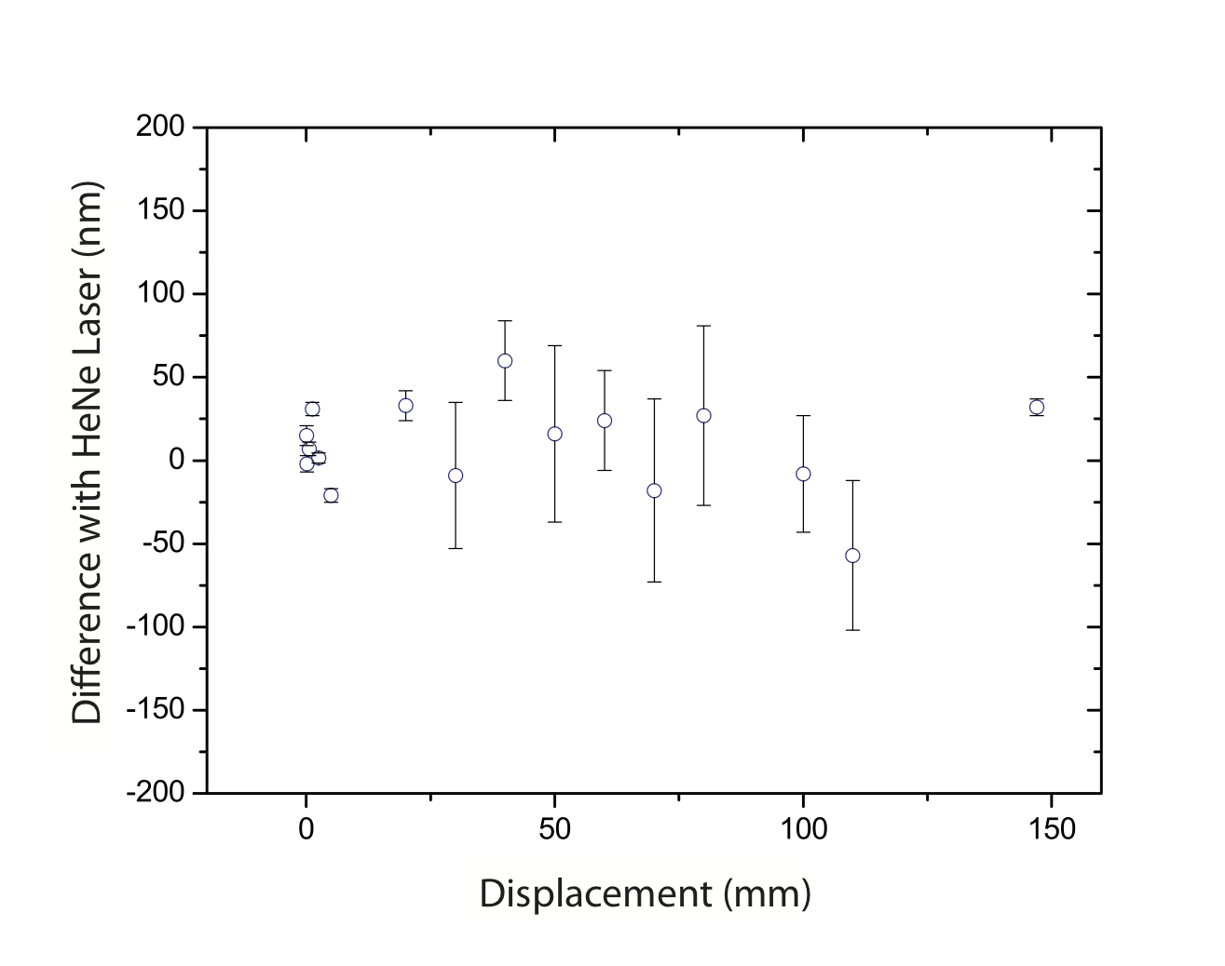
Comparison to counting interferometer
Average difference 8 nm,
Std. dev 28 nm

Slide 24
Discussion
Interference pattern will repeat itself. Only multiples of L_{pp}/2 need to be added for longer distances
A coarse measurement only needed to determine the integer number of L_{pp}/2, (i.e. within 15 cm), e.g. with time-of-flight, EDM.
All distances can be measured, even at maximum pulse separation.
Spectral interferometry and multiwavelength interferometry merged in a single scheme.
Only one frequency comb needed (compared to heterodyne comb interferometry).
Interferometer stability and HeNe accuracy currently limits comparison

Slide 25
Conclusions
The fs frequeny comb is powerful tool for distance measurement.
Novel concept of interferometry demonstrated, based on mode-resolved frequency comb.
  Unprecedented resolution achieved with VIPA spectrometer
Exploitations of thousands of comb modes allows for interferometry with huge range of non-ambiguity.
An accuracy of λ/30 has been demonstrated, limited by interferometer stability.
S.A. van den Berg, G.J.P. Kok, S.T. Persijn, M.G. Zeitouny and N. Bhattacharya,
Many-wavelength interferometry with thousands of lasers for absolute distance measurement, Phys. Rev. Lett. 108 183901 (2012)

Slide 26
Follow up options
Investigation of ultimate accuracy of measurement method
  Improved interferometer design (stability)
  Refine data-analysis
  Improvement on optical imaging? Suppression spurious reflections.
  Determination of fundamental limits of many-wavelength method
Demonstration on longer distance (50 m, 600 in field targeted)
Reduce number of modes from comb with filter cavity
  Allows for use of fiber-based frequency comb
  Simpler spectrometer can be used

Slide 27
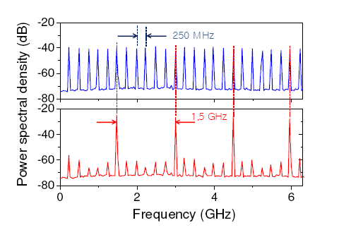
Mode-filtering
L₁
L₂
Reduce number of wavelengths with a filter cavity

Slide 28
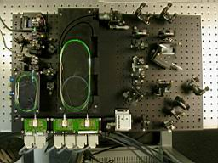
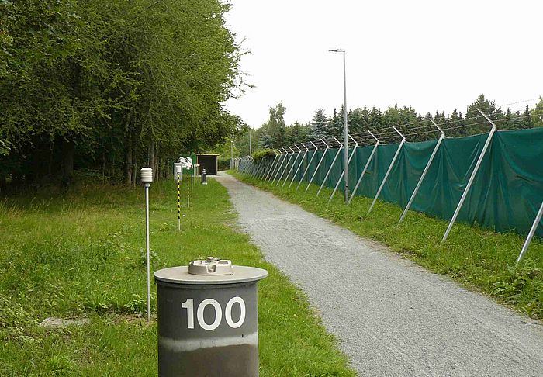
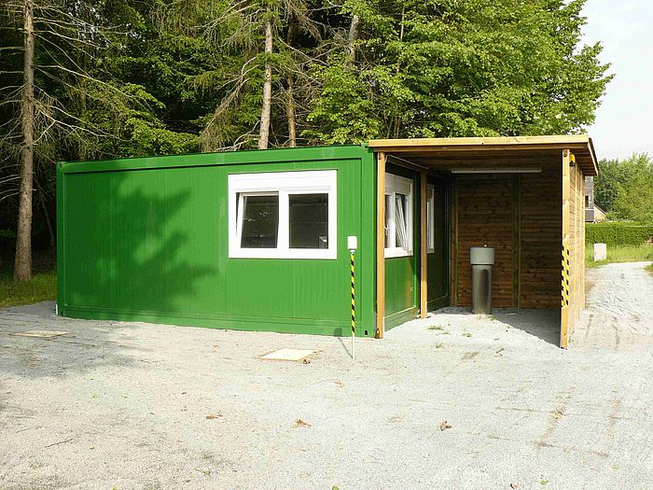
Application to distance measurement
Aims to demonstrate comb-resolved distance measurement in ‘field’ conditions with a fiber laser
Collaboration with TU Delft for preparation phase
Field comparison at PTB baseline

Slide 29


VSL team
Gertjan Kok
Stefan Persijn
Steven van den Berg
Thanks for you attention
TU Delft team
Morris Cui (PhD 2010)
Mounir Zeitouny (PhD 2011)
Nandini Bhattacharya
Paul Urbach
Joseph Braat
Funding
Euramet iMERA plus programme
EURAMET EMRP JRP Long Distance surveying

