Slide 1
Modeling of Cable Suspension for the Carlina
Torben Andersen¹
Mette Owner-Petersen¹
Hervé Le Coroller²
¹ Lund Observatory, Sweden
² Observatoire de Haute Provence, France
Main skepticism: Can you keep the gondola
positioned sufficiently accurately?
(Cable dynamics!!)

Slide 2
Outline
Summary of 2011 study
Cable Model
Choice of design parameters

Slide 3
Integrated Modeling
Segmented Mirrors
Telescope
Structure
Segmented Mirror
Control
Telescope
Optics
Established software infrastructure
Modelled Euro50
European ELT (E-ELT)
Thirty Meter Telescope (TMT)
Wrote Springer text book on integrated modeling
Used framework for Ubaye Carlina simulation 2011
Integrated
Model
Segment
Actuators
Deformable
Mirrors
Servo
Mechanisms
Reconstructor
Lenslet
Arrays
CCD

Slide 4
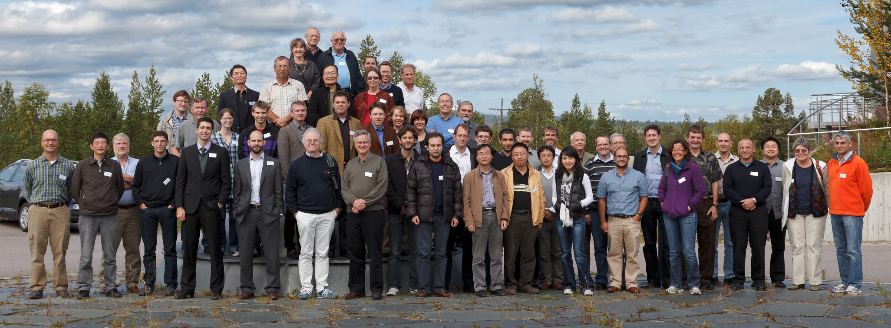
Carlina Study 2011
Anita Enmark ; Torben Andersen ; Mette Owner-Petersen ; Rijuparna Chakraborty and Antoine Labeyrie:
"Integrated model of the Carlina Telescope“
Proc. SPIE 8336, Integrated Modeling of Complex Optomechanical Systems, 83360J (November 10, 2011)

Slide 5
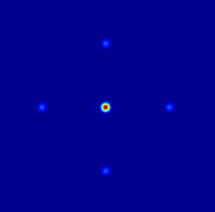
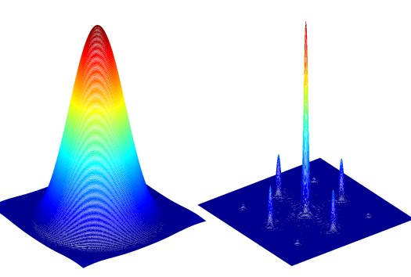
Carlina Study 2011
Model Structure
Gondola
forces
6 dof rigid-body motion
of Gondola
Wind
PSFs
etc
Cables
Gondola
Optics
Model
Winch
Controller
Ubaye Geometry
Generic study

Slide 6
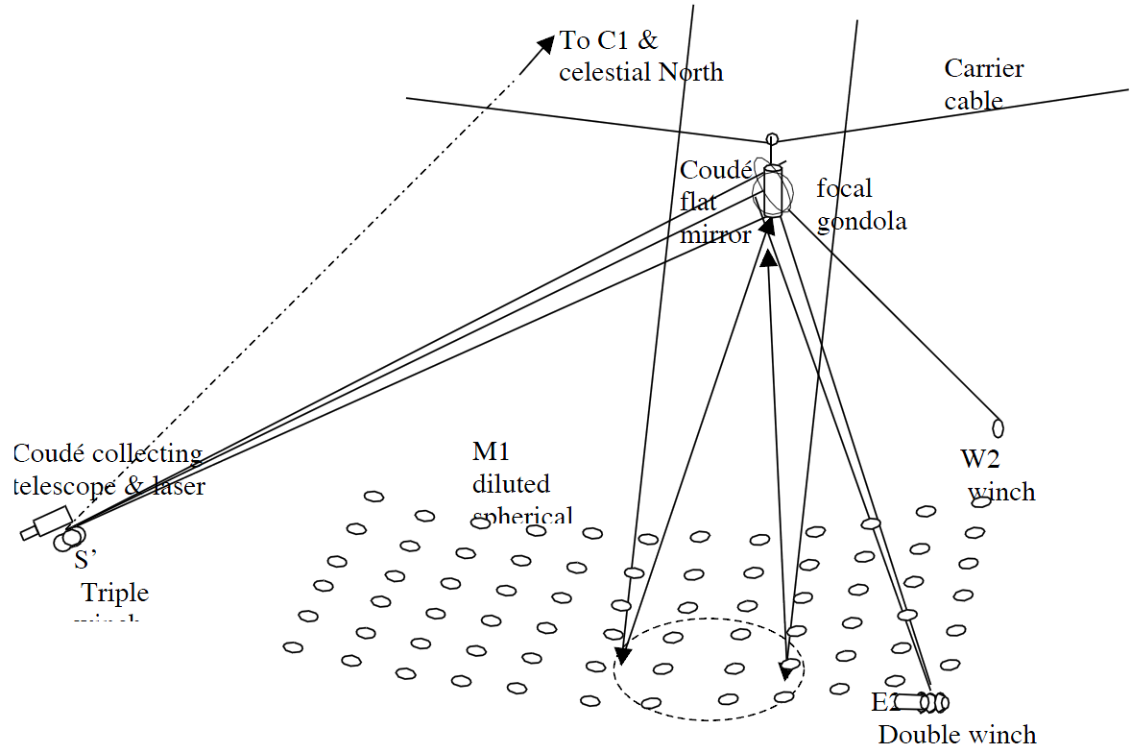
Cable Suspension Submodel 2011
Re: A. Labeyrie

Slide 7
Conclusions of Study
Ubaye concept may fulfill tolerances for short exposures
Difficult for long exposures:
  Two orders of magnitude in gondola position/tilt
More robust cable models and design parameter studies would be useful
Gondola position control approach important for project fundability

Slide 8
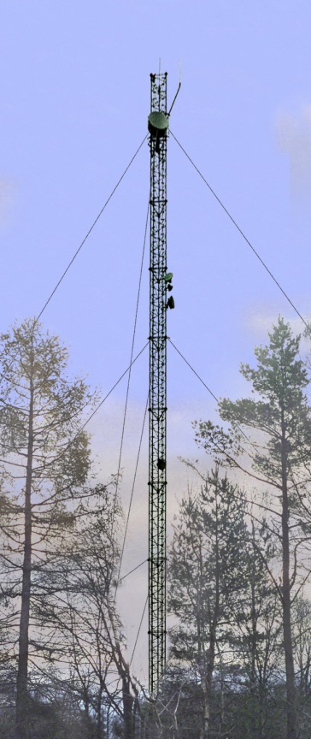
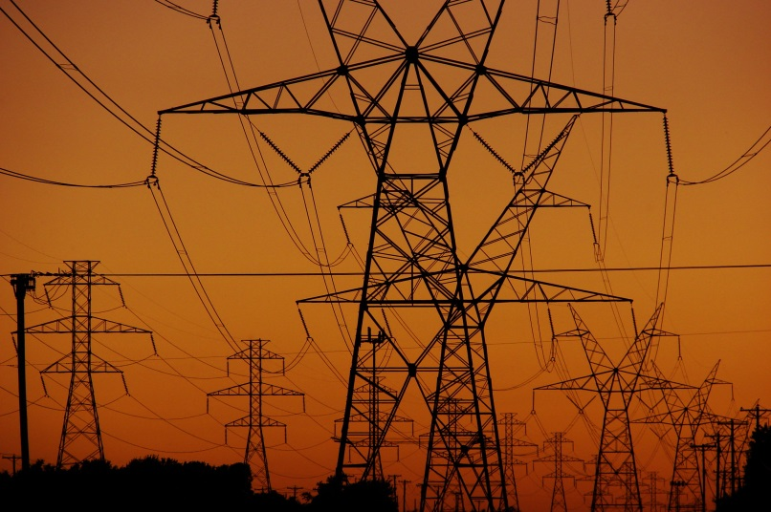
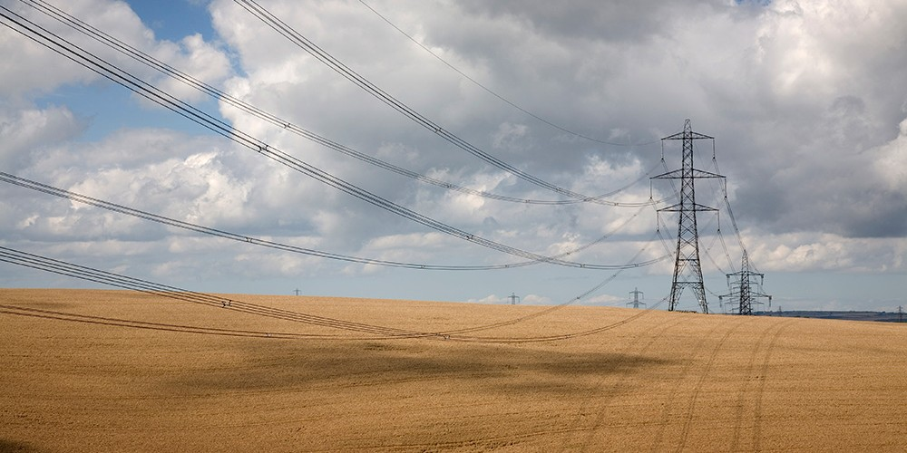
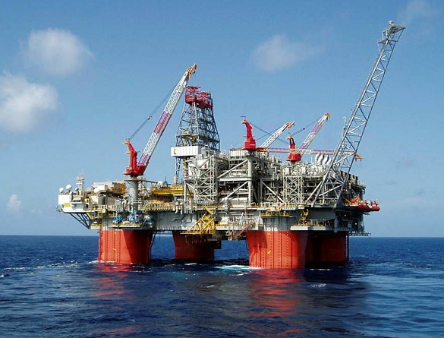
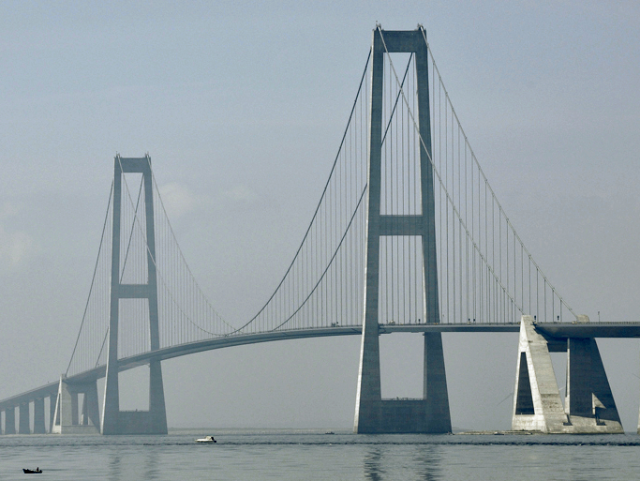
Some Cable Applications

Slide 9
Two Approaches Possible
Partial Differential Equations (PDE)
    Used for 2011 study
    Difficult to convert to first-order linear set of equations
Non-linear finite element model
    Make your own FE environment
    (Matlab)

Slide 10
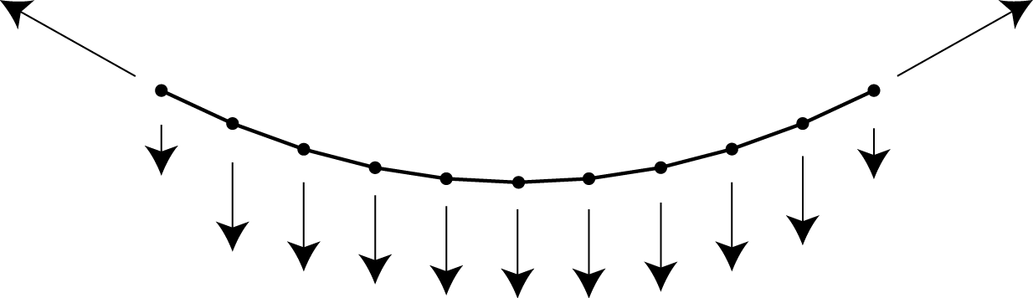
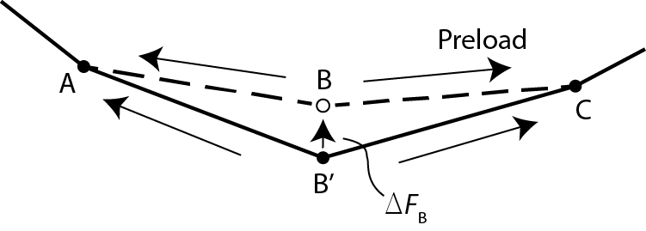
Non-Linear FE Model

Slide 11
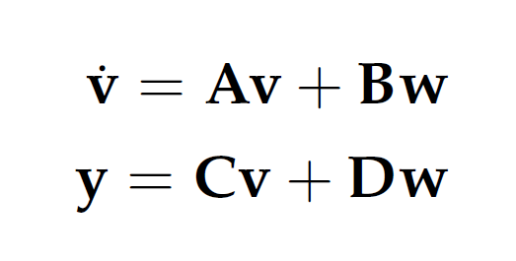
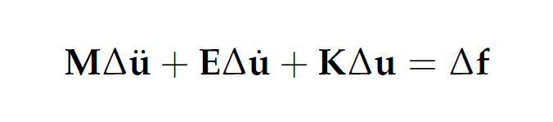
Modeling Approach
Set up geometrical and elastic stiffness matrices
Through iteration, determine ”exact” static form
For this operating point, determine eigenvectors and eigenfrequencies
Convert second-order model to first-order linear differential equations valid near operating point (2-300 states per cable)
Second-order model
First-order state-space
ABCD-model
(See paper for full equations)

Slide 12
Strawman Example
Similar to one Ubaye Cable
185.8 m
1344 N
0.121 m
Gravity
1.8 mm Kevlar 29
Mass 0.71 kg
Fracture stress 2923 Mpa (steel is ~2000 Mpa)
Preload stress 400 Mpa
E-modulus 70 Gpa (steel is 210 Gpa)
Density 1440 kg/m³ (steel is 7800 kg/m³)
Model with 40 elements
Taut wire regime: Deflection < 1/8 * chord length: Nearly parabolic
Slack wire regime: Deflection > 1/8 * chord length: Catenary

Slide 13
Three Types of Eigenmodes
Fixed End Supports
Eigenmode | Symmetry | Influence
In-plane | Symmetrical Anti-symmetrical | Important Little important
Out-of-plane | Symmetrical Anti-symmetrical | All unimportant
Axial | Symmetrical Anti-symmetrical | All important

Slide 14
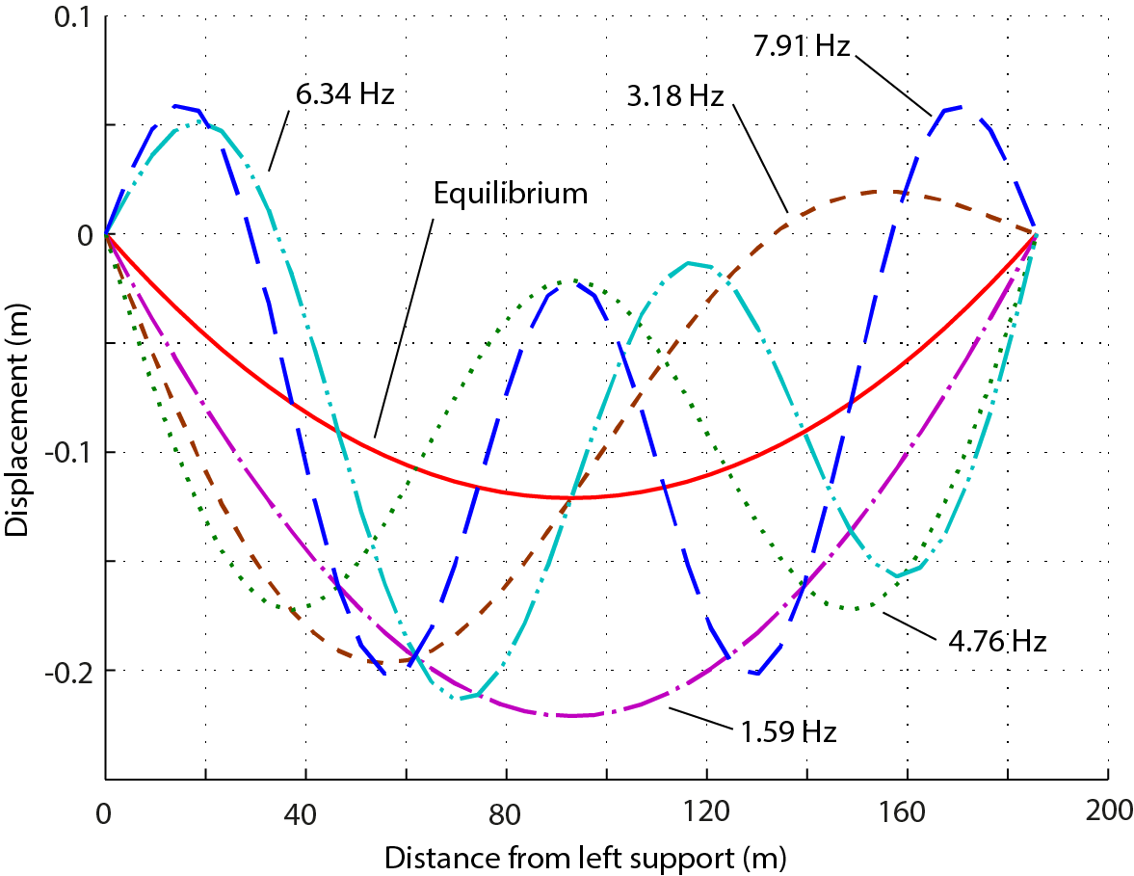
In-Plane Eigenmodes
Strawman Example
Fixed end supports

Slide 15
Eigenmode Summary
Strawman Example
Number | Type | Symmetry | Eigenfrequency | Participation factor¹
1 | out-of-plane | symmetrical | 1.59 | 0
2 | in-plane | symmetrical | 1.59 | 5.63
3 | in-plane | anti-symmetrical | 3.18 | 0.4
4 | out-of-plane | anti-symmetrical | 3.18 | 0
5 | out-of-plane | symmetrical | 4.76 | 0
6 | in-plane | symmetrical | 4.76 | 1.52
7 | in-plane | anti-symmetrical | 6.34 | 0.83
8 | out-of-plane | anti-symmetrical | 6.34 | 0
9 | out-of-plane | symmetrical | 7.90 | 0
10 | in-plane | symmetrical | 7.90 | 0.49
13 | in-plane | symmetrical | 11.0 | 0.09
17 | in-plane | symmetrical | 14.0 | 0.51
25 | axial | symmetrical | 18.9 | 5380
62 | axial | anti-symmetrical | 37.8 | 10700
81 | axial | symmetrical | 56.7 | 16000
82 | axial | anti-symmetrical | 75.4 | 21200
83 | axial | symmetrical | 94.1 | 26200
¹ for a horizontal translation of end point
There is good agreement with analytical model and speed-of-sound model

Slide 16
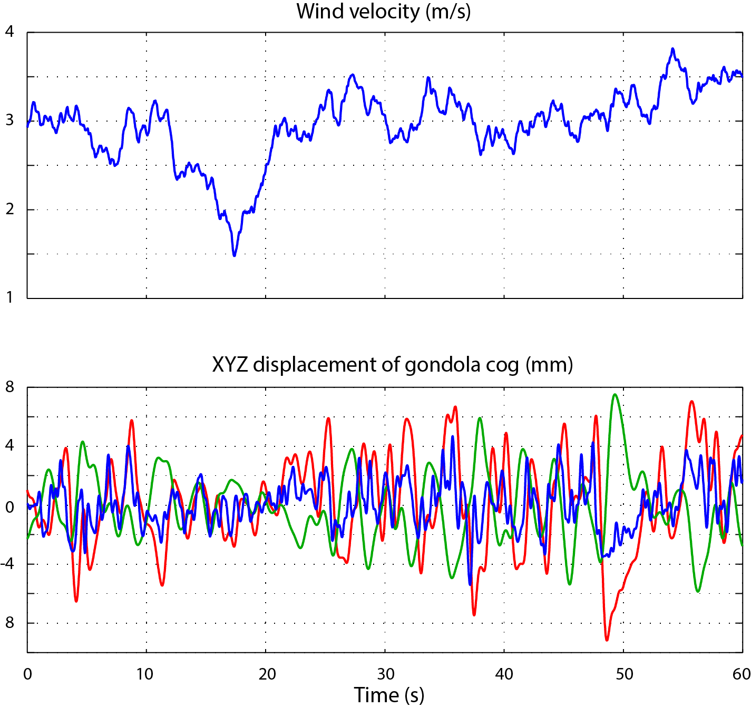
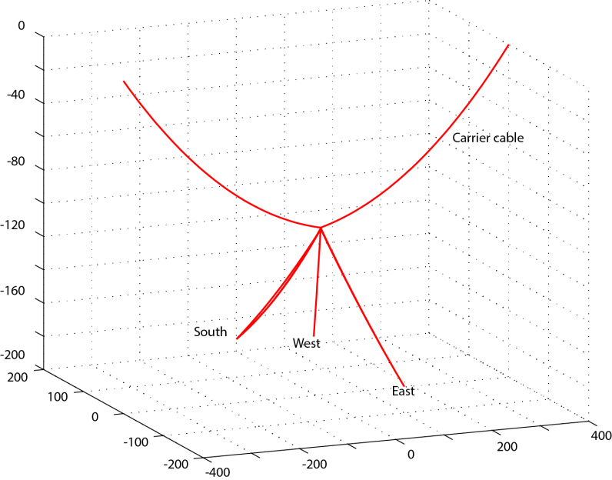
Model of Ubaye
3 m/s Wind
Sag exaggerated 5x

Slide 17
Wind Effects
Wind on gondola
Wind on cable
PSD
Flutter
(Vortex Shedding)
Excitation of
In-plane
eigenmodes
TF
PSD
100-600 Hz
Eddy size
6-30 m for 0.2-1 Hz
Drag at 0.2-1 Hz
is critical
Only an issue
near gondola

Slide 18
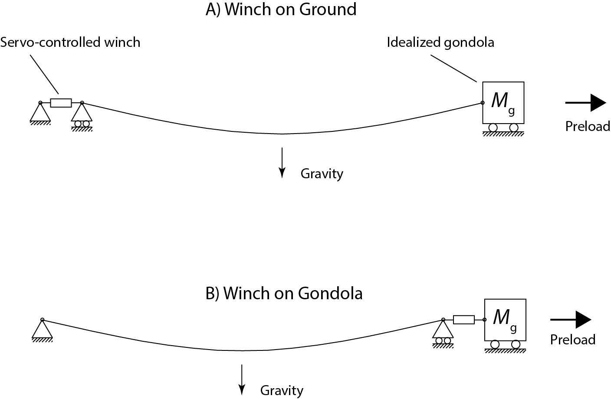
Winch on Ground or on Gondola?
Inherent dynamics are the same for the two cases; input is different

Slide 19
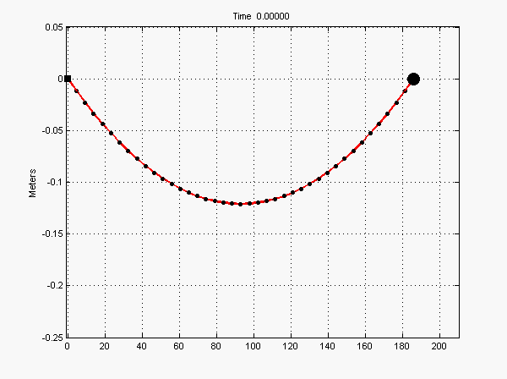
Position Step at Left Cable End
Strawman Example
Kevlar cable
Diam 1.85 mm
Chord 185.8 m
Gondola mass 50 kg
Cable mass 0.71 kg
Cable static stiffness 1024 N/m

Slide 20
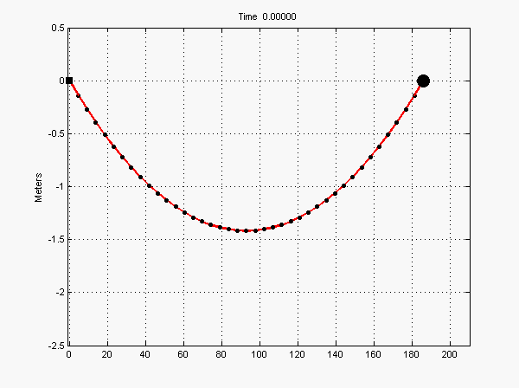
Position Step at Left Cable End
Thicker Cable
Steel cable
Diam 4 mm
Chord 185.8 m
Gondola mass 50 kg
Cable mass 18.2 kg
Cable static stiffness 11105 N/m

Slide 21
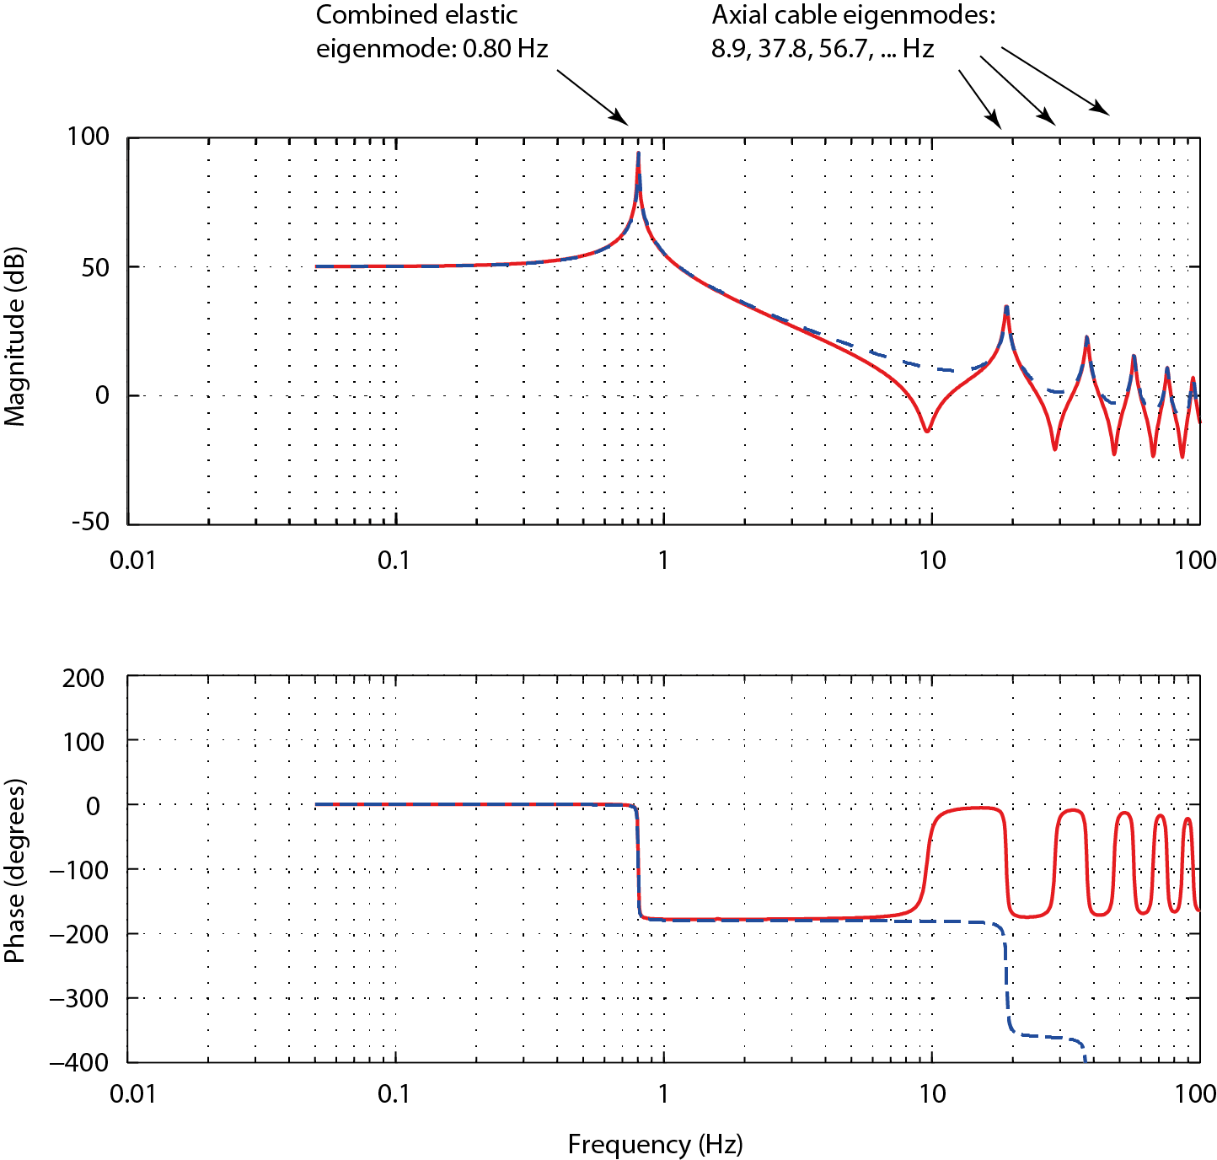
Winch on Ground or Gondola?
Strawman Example with 50 kg Gondola
Input:
Winch on left end (blue)
Winch on gondola (red)
Output:
Gondola position
Conclusion:
Having winch on gondola is as bad as having it on ground

Slide 22
Which Cable Diameter?
Strawman Example
Cable diameter (mm) | Cable mass (kg) | Typical preload (N) | Crosswind force at 6 m/s (N) | Static stiffness along chord (N/m) | RMS Gondola excursion¹ (mm)
1.85 | 0.72 | 1340 | 7.24 | 1020 | 21.8
3.70 | 2.88 | 5380 | 14.5 | 4100 | 2.50
5.55 | 6.47 | 12100 | 21.7 | 9200 | 0.72
7.60 | 11.5 | 33600 | 29.0 | 16400 | 0.31
¹ Due to wind at 6 m/s acting on gondola,
and closed loop position control with winch
Conclusion:
Thicker cables are much better

Slide 23
Is a Large Cable Preload Attractive?
Strawman Example with cable diameter 5.4 mm
Cable preload (N) | Length of Unstressed cable (m) | Cable sag at Equilibrium (m) | Static Stiffness at end (N/m) | Lowest in-plane Cable eigen- frequency (Hz) | Lowest gondola eigenfrequency (Hz)
24200 | 183.195 | 0.601 | 9287 | 2.26 | 2.17
12100 | 184.488 | 0.121 | 9219 | 1.59 | 2.16
6056 | 185.142 | 0.243 | 9166 | 1.13 | 2.15
1363 | 185.668 | 1.081 | 7480 | 0.59 | 1.95
933 | 185.734 | 1.580 | 5380 | 0.57 | 1.65
361 | 186.000 | 4.088 | 698 | 0.55 | 0.59
Conclusion:
Above a certain limit, then the system is not very sensitive to preload

Slide 24
Is a large E-Modulus Useful?
Strawman Example, preload 1344 N
 | E=70 GPa | E=23.4 GPa | E=7 GPa
Cable eigenfrequency (mode 2) | 1.59 | 1.60 | 1.64
Cable eigenfrequency (mode 6) | 4.76 | 4.80 | 4.91
Cable eigenfrequency (mode 10) | 7.90 | 7.96 | 8.15
Cable eigenfrequency (mode 25) | 18.9 | 11.1 | 6.37
Cable eigenfrequency (mode 62) | 37.8 | 22.2 | 12.7
Static stiffness (N/m) | 1024 | 346 | 109
Sag (m) | 0.121 | 0.119 | 0.114
Lowest gondola eigenfrequency (Hz) | 0.72 | 0.42 | 0.24
Closed loop wind excursion of gondola, RMS (mm)¹⁾ | 18 | 63 | 196
¹⁾ with 50 kg gondola mass
Conclusion:
Take the highest E-modulus you can get

Slide 25
Which Density?
Case 1: High preload
Density (kg/m³) | 1440 | 7800
Preload (N) | 673 | 614
Sag (m) | 0.243 | 1.271
Lowest cable eigenfrequency (Hz) | 1.13 | 0.51
Static stiffness at end (N/m) | 1019 | 956
Lowest gondola eigenfrequency (Hz) | 0.72 | 0.71
Case 2: Low preload
Density (kg/m³) | 1440 | 7800
Preload (N) | 40 | 174
Sag (m) | 0.851 | 5.09
Lowest cable eigenfrequency (Hz) | 0.55 | 0.49
Static stiffness at end (N/m) | 77.6 | 191
Lowest gondola eigenfrequency (Hz) | 0.49 | 0.31
Conclusion:
For reasonably high preloads, the density is not so important

Slide 26
Which Material?
Material | Tensile strength (Mpa) | Density (kg/m³) | E-modulus (Gpa)
Polypropylene | 60 | 930 | 5
Polyester (Dacron) | 1150 | 910 | 15
Polyamid (Nylon) | 1000 | 1140 | 4
Aramid (Kevlar) | 3000-3500 | 1440 | 70-140
Steel | 1500-2000 | 7800 | 210
Stainless steel (Inox) | 500-1000 | 7850 | 200
Conclusion:
Aramid (Kevlar) or galvanized steel

Slide 27
Conclusions
State-space simulation model ready
    Need a predesign
Kevlar or Steel
Take the largest cable diameter feasible
    5-7 mm at L~180-200 m
    Reduces influence of wind on gondola significantly
Use a reasonably high preload
    Axial elasticity should dominate over geometrical elasticity
    Reduces influence of cable dynamics and wind on cable
Wind load on gondola dominates over wind load on cable
Reaction wheels and masses seem necessary
    Detailed study advisable once the geometry is chosen

Slide 29
Cable Modeling Challenge
Load carried through change of geometry
Usual finite element methods break down

